Slide 1
Water Sampler Project
Group C members:
Grant Eyer, Joshua Hagan, Christian Gratz, Dorian Lewis, and Garrett Matheny

Slide 2
Team Members and Responsibilities
Dorian Lewis was the primary for the sampler stand and the secondary for the control code.
Christian Gratz was the primary for the rotational base and the secondary for the pipette squeezer.
Joshua Hagan was the primary for the pipette squeezer and the secondary for the sampler stand.
Garrett Matheny was the primary for the vision system and the secondary for the rotational base.
Grant Eyer was the primary for the control code and the secondary for the vision system.

Slide 3
Project Description and Constraints
Our team was tasked to design a water sampler machine that would:
Move two containers with a rotational base: one with a water sample and the other one empty.
Be able to hold and squeeze a pipette to transfer 1 mL of water from the sample container to the empty container.
Be able to move the pipette both up and down. The pipette tip needs to be 1 cm above the sediment layer during extraction.
Reset appropriately once the sampling cycle is complete.
Constraints on our design
Hard constraints
Sample must function by computer control, with the exception of loading and unloading the containers.
The sampling cycle must not take longer than four minutes and occur without manual intervention once started.
Soft constraints
Must be relatively portable and/or easy to assemble.
Should be relatively affordable for potential consumers.

Slide 4
Overall Water Sampler Design

Slide 5
Overall Concept for Water Sampler Design
Functionality
Our Water Sampler Stand was designed so that it could readily assembled and dissembled. Our water sampler stand consists of a separate sampler stand component and rotational base component that are linked together through pegs.
The sampler stand component consists of a gear rack that is attached to a gear on a stepper motor. There is some space underneath the stand that contains a webcam and its stand.
The rotational base component has two gears: one gear lies underneath the rotational base while a stepper motor moves a larger outside gear. There was also additional room on this piece to place our Arduino and breadboard components.
To maximize usability, a USB hub was used to ensure that any one of our team members to operate the Control Code and its corresponding GUI.

Slide 6
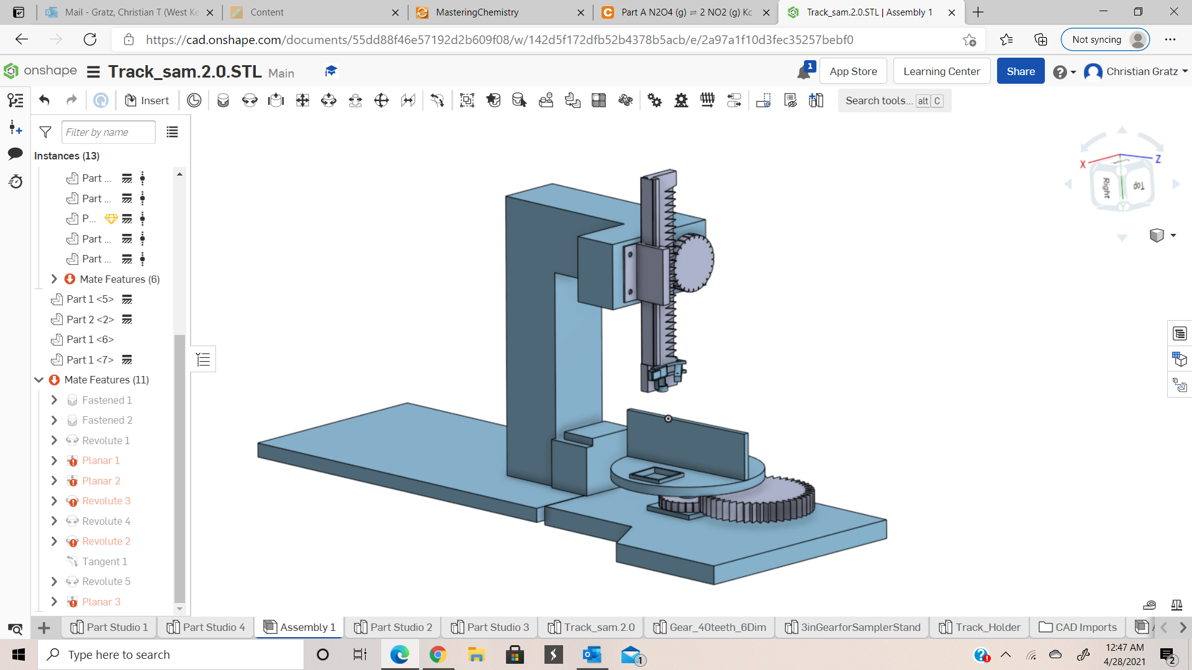
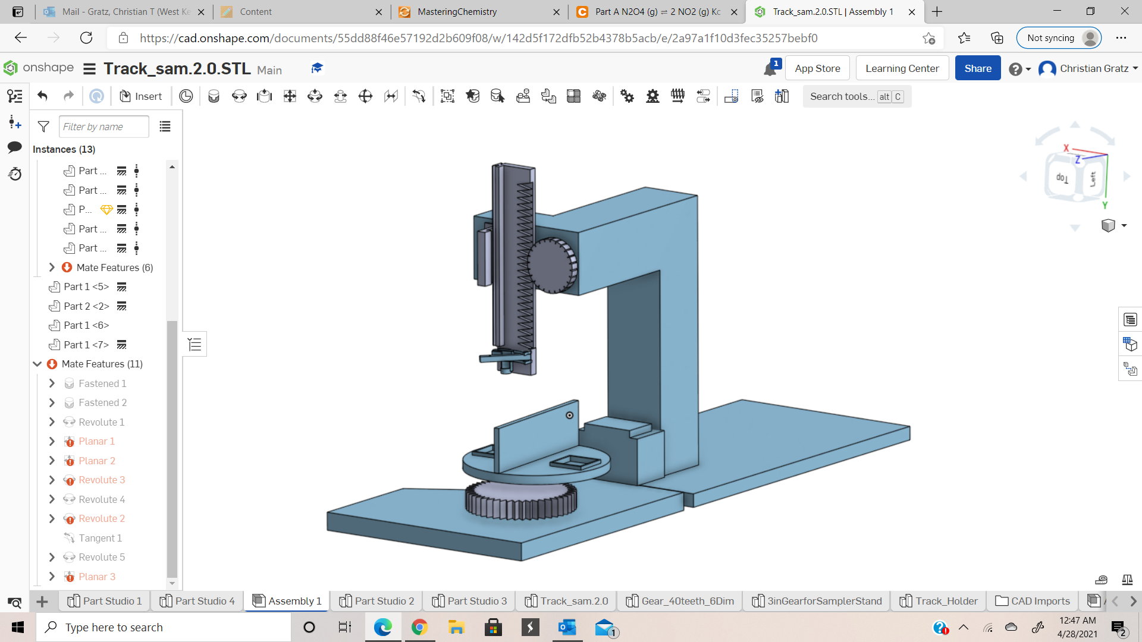
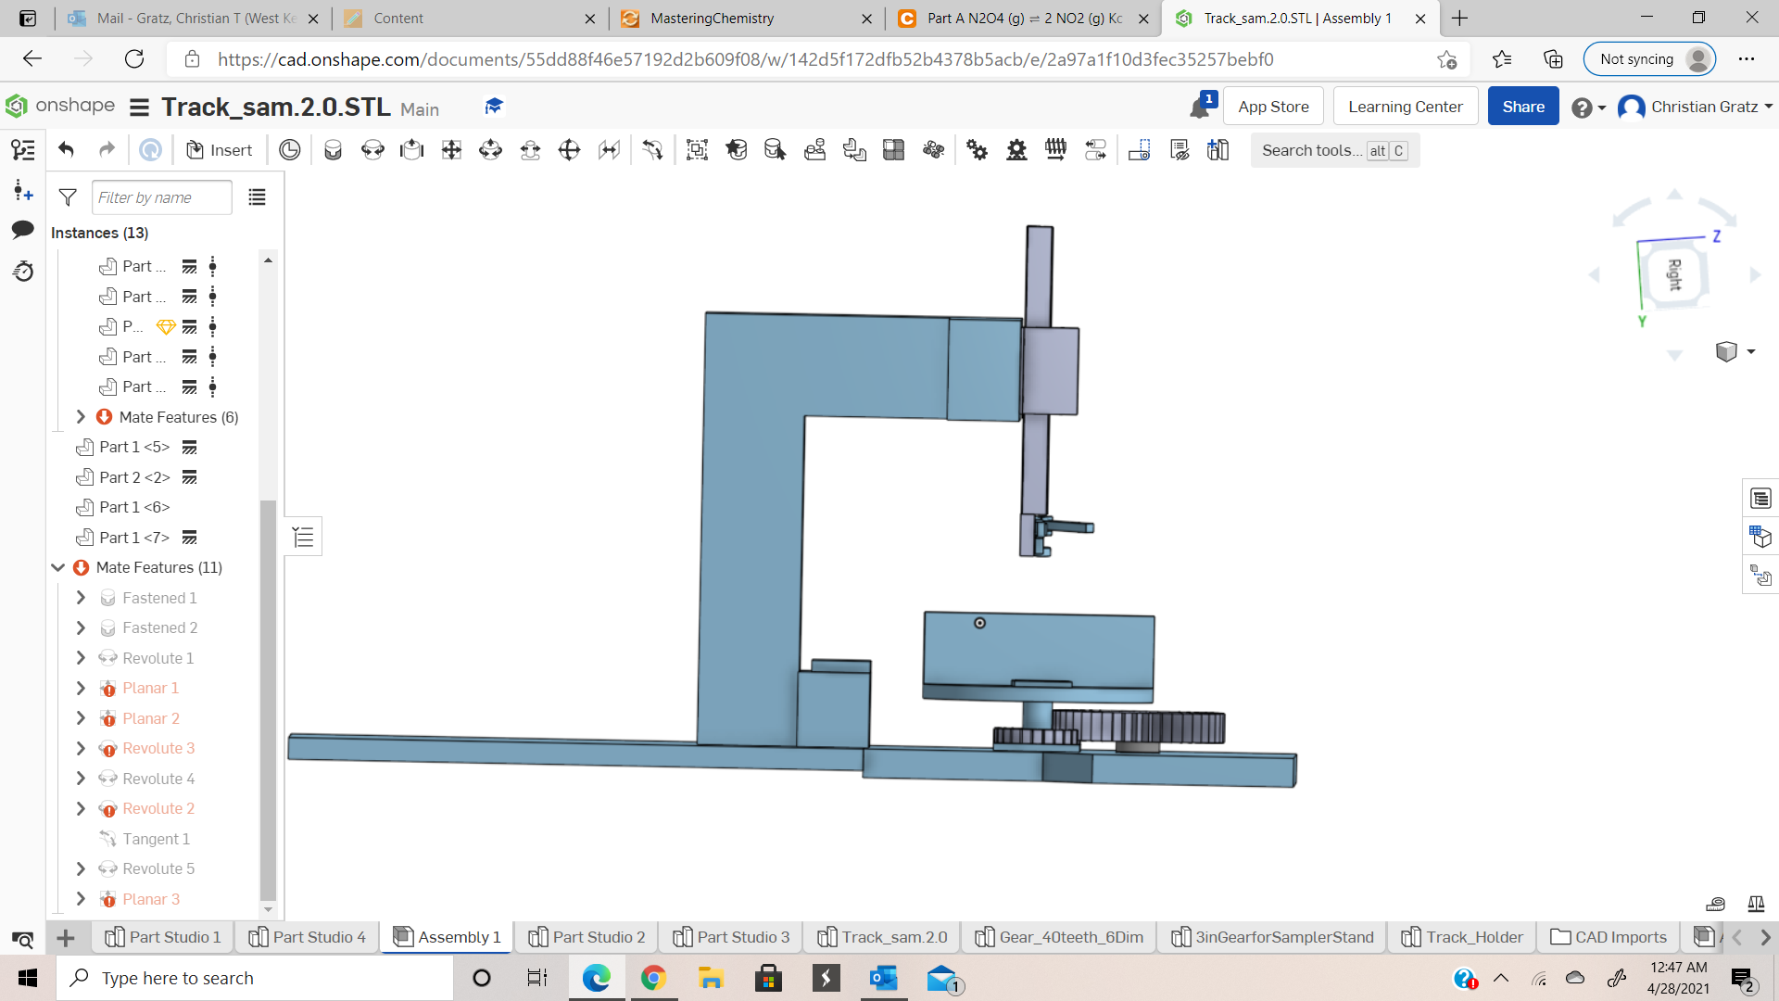
Water Sampler Overall Design

Slide 7
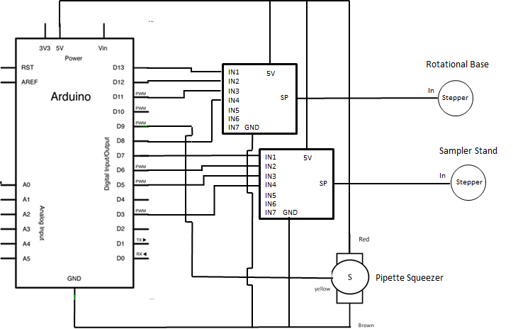
Overall Electrical Schematic

Slide 8
Subsystem Overviews

Slide 9
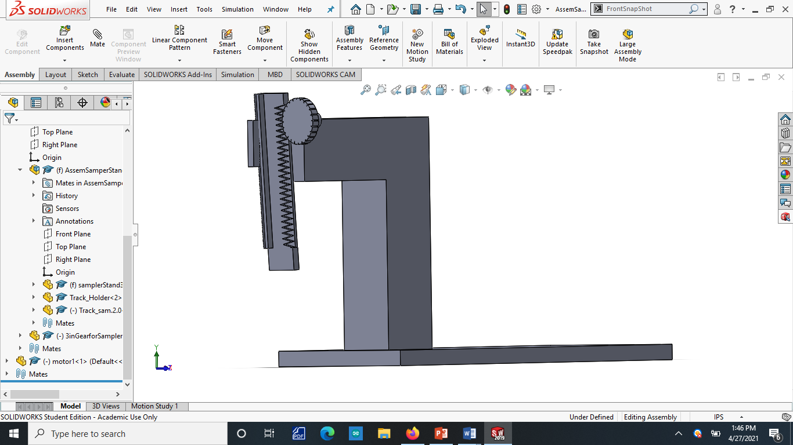
Sampler Stand and CAD Drawing
Goal
Design
The goal of the stand is to bear the weight of the pipette and the lifting mechanism.

Slide 10
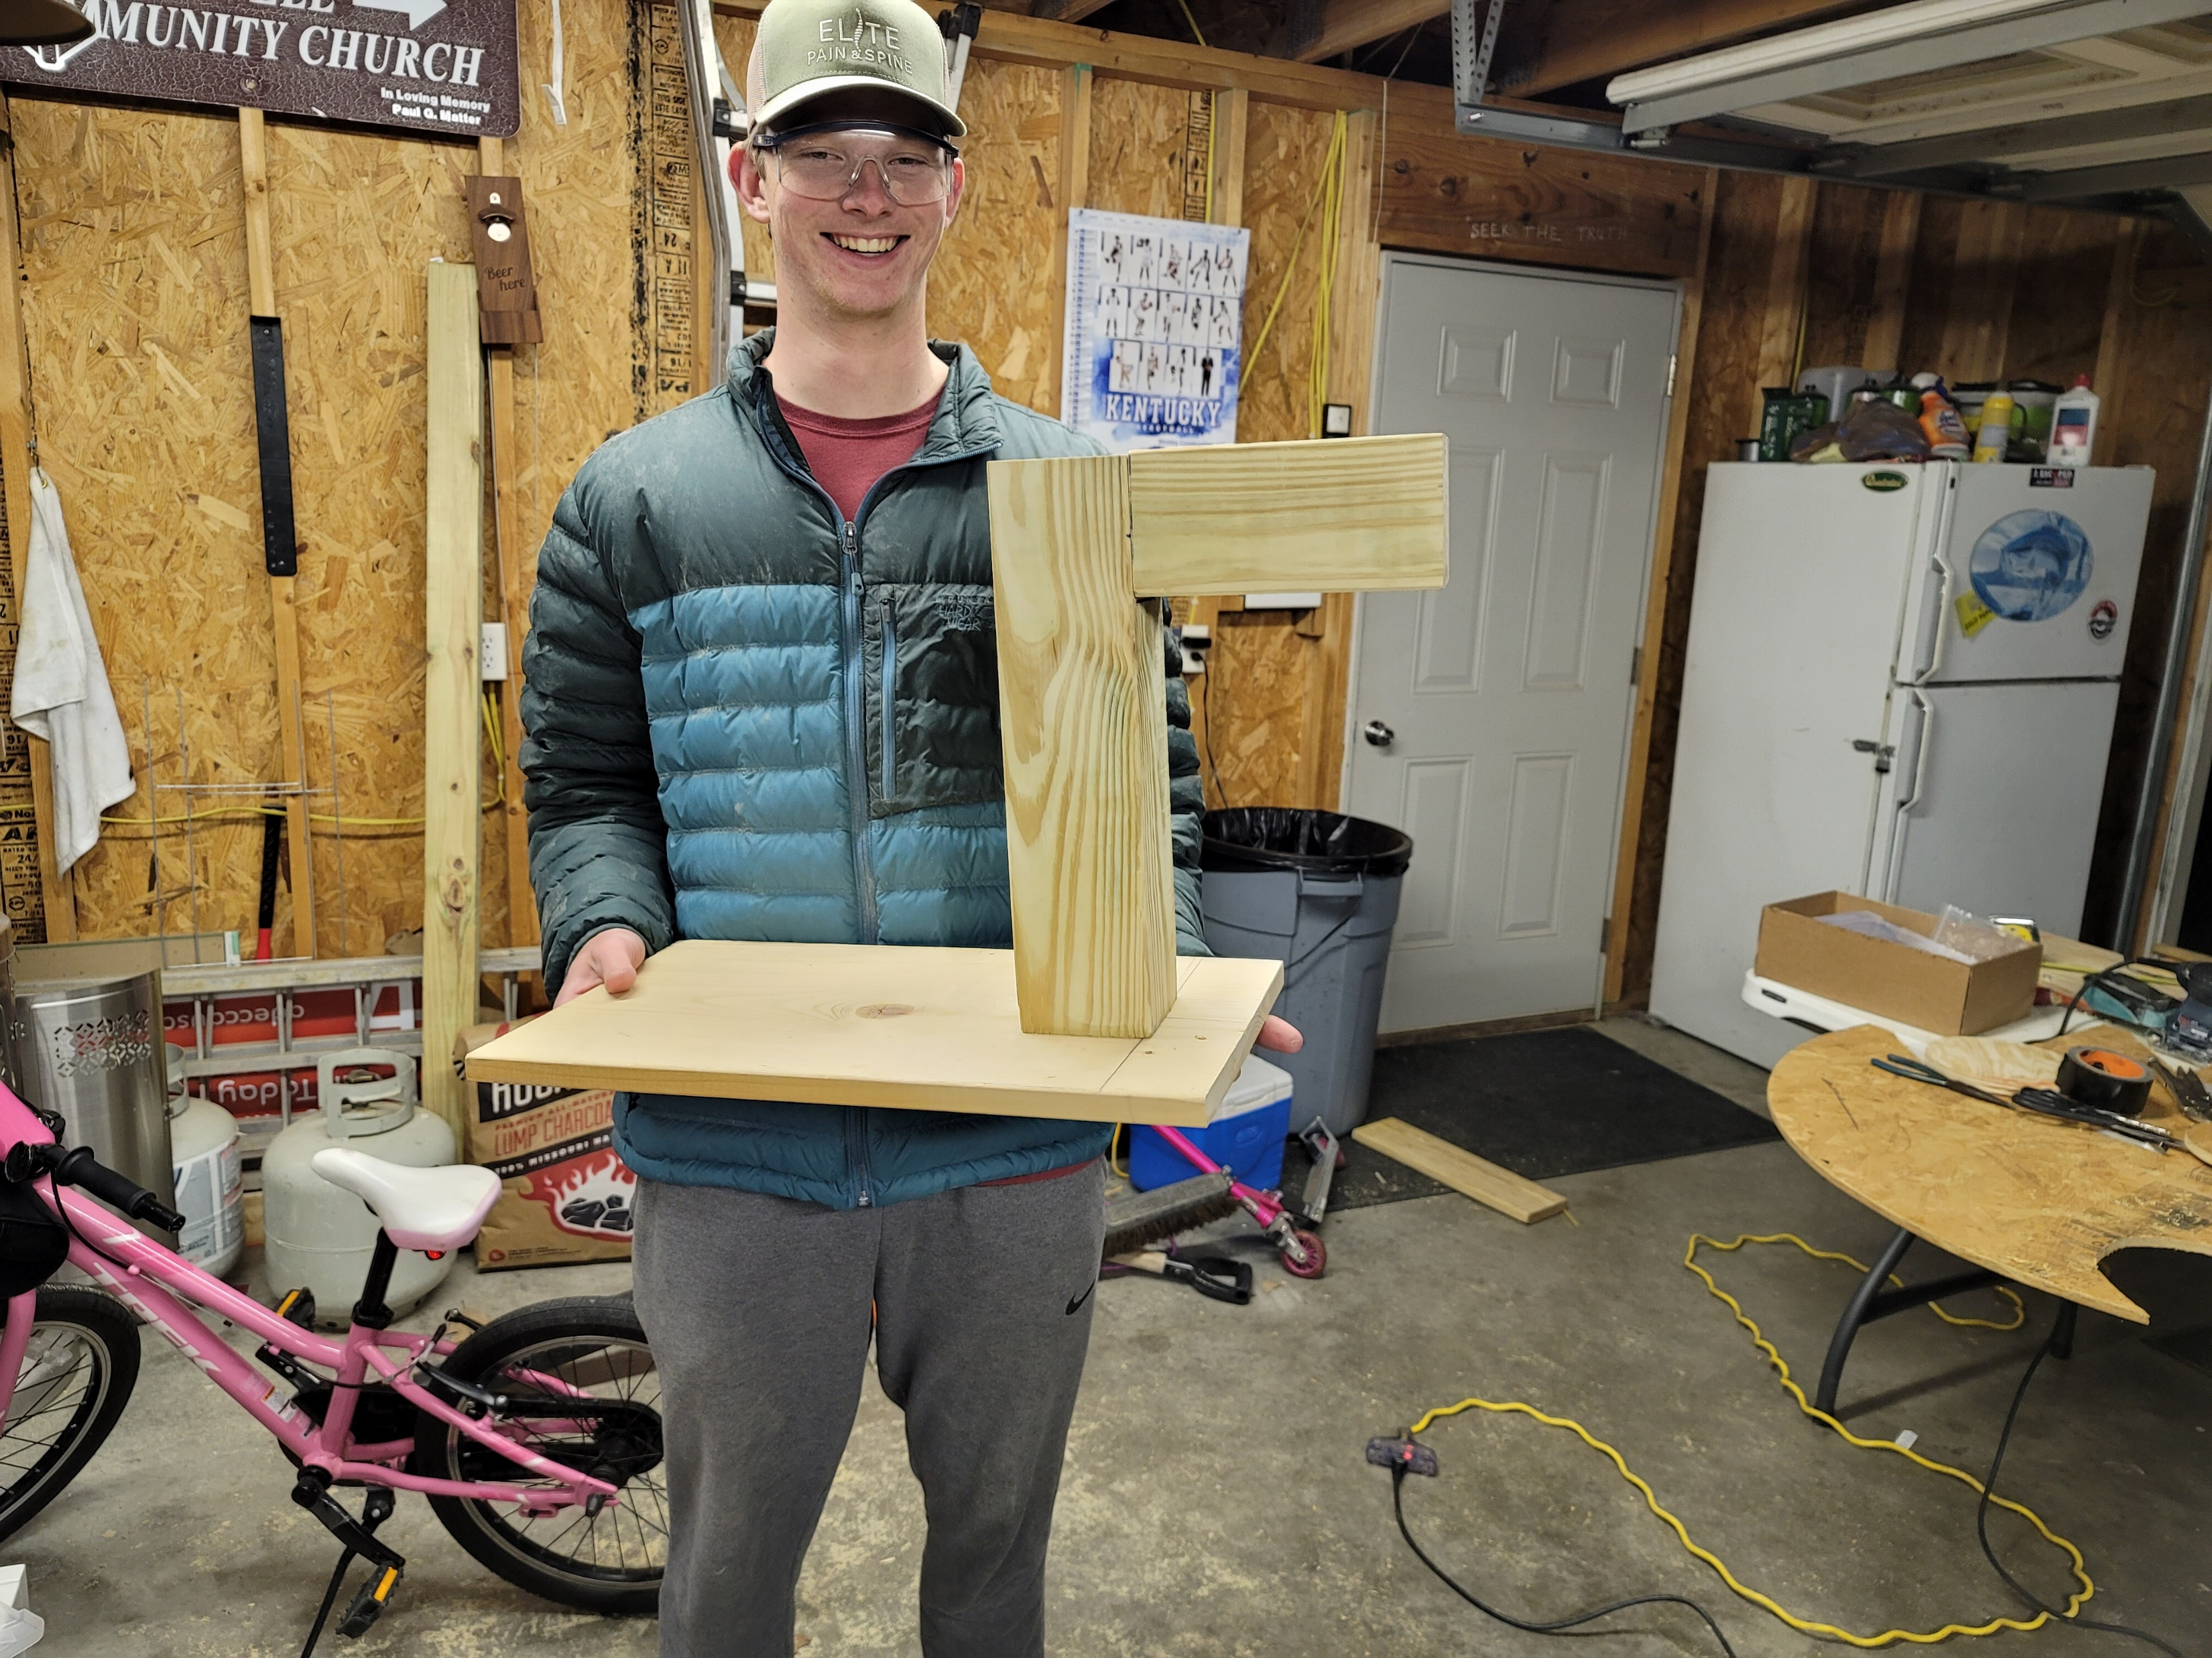
Prototype

Slide 11
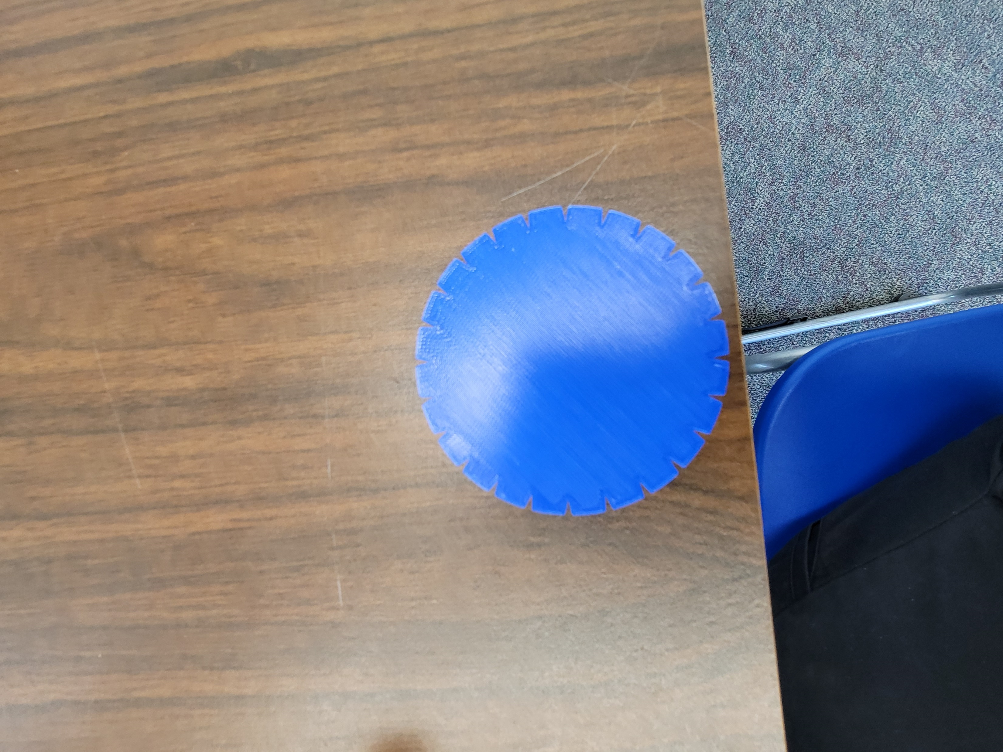
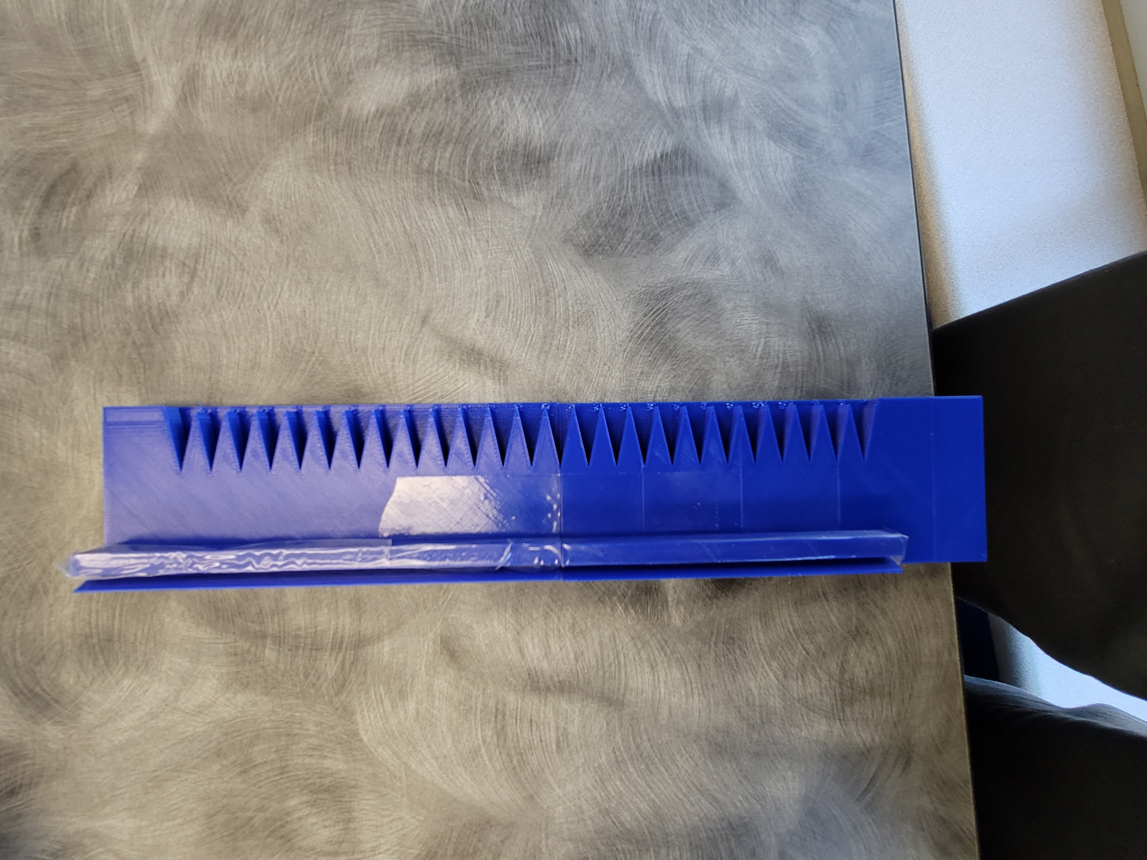
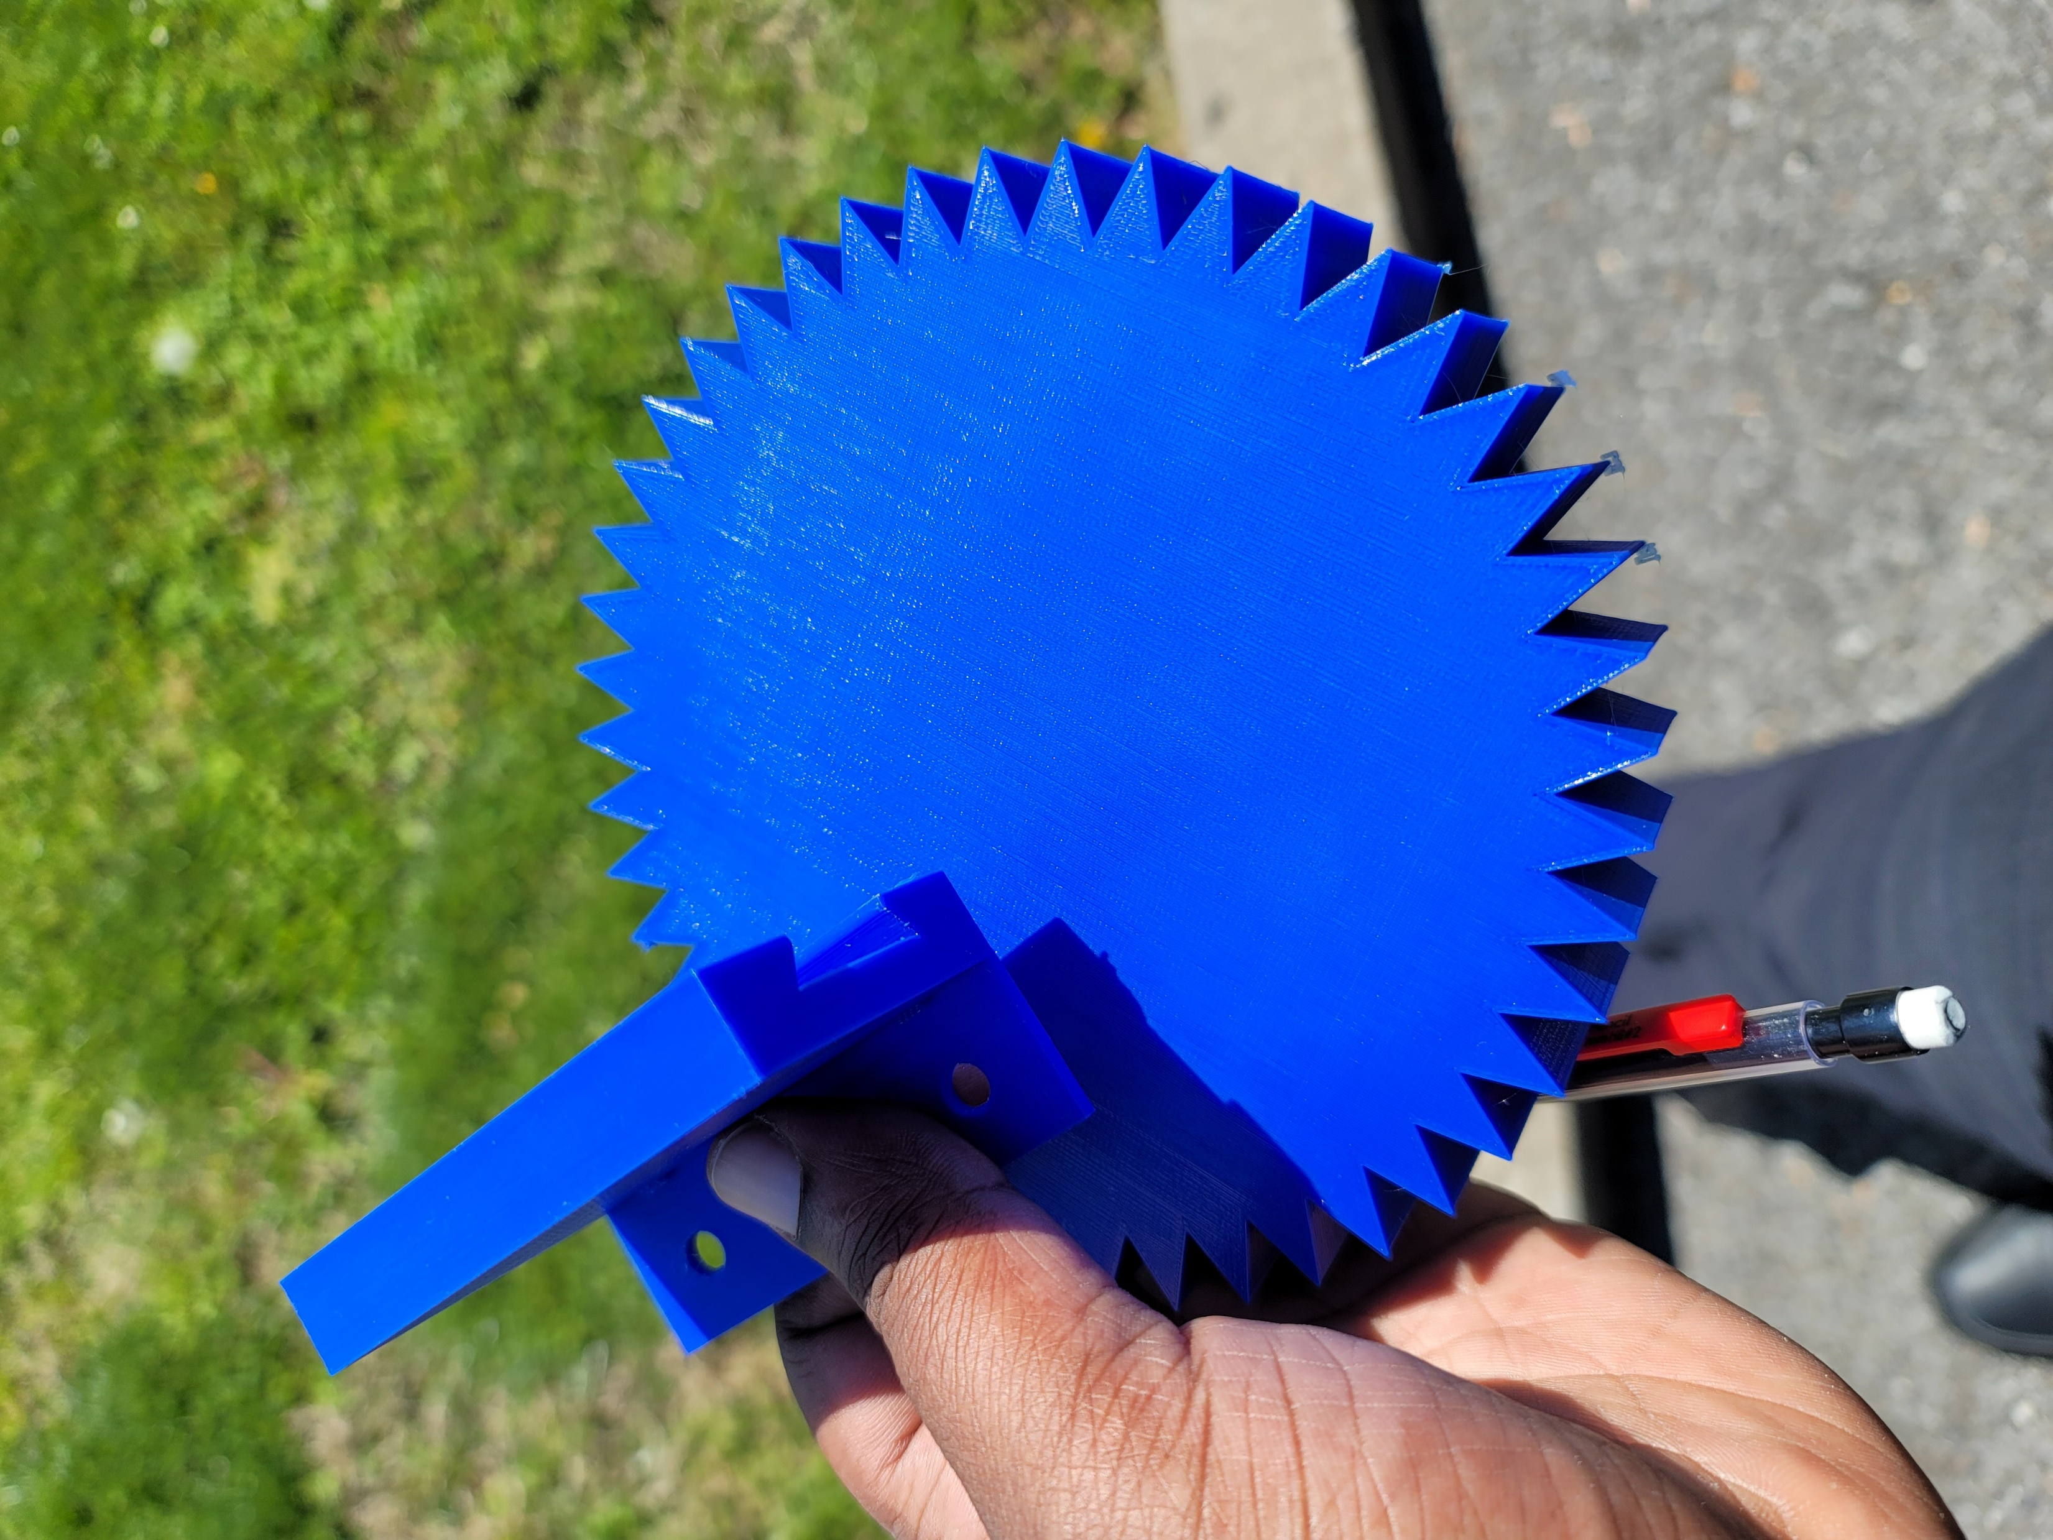
Sampler Stand Gear Components

Slide 12
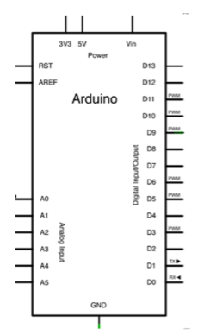
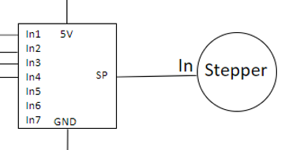
Sampler Stand Schematic

Slide 13
Mathematical model
Above the 1200 gf*cm range is ground for a failure
600 gf*cm is within a good margin

Slide 14
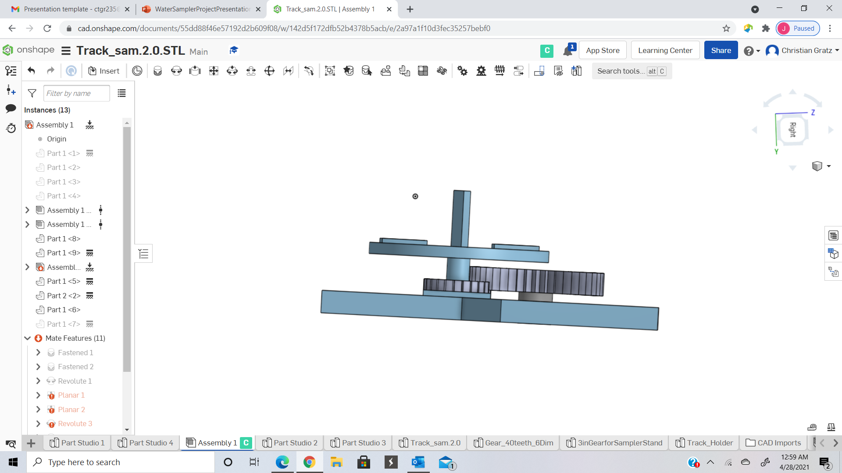
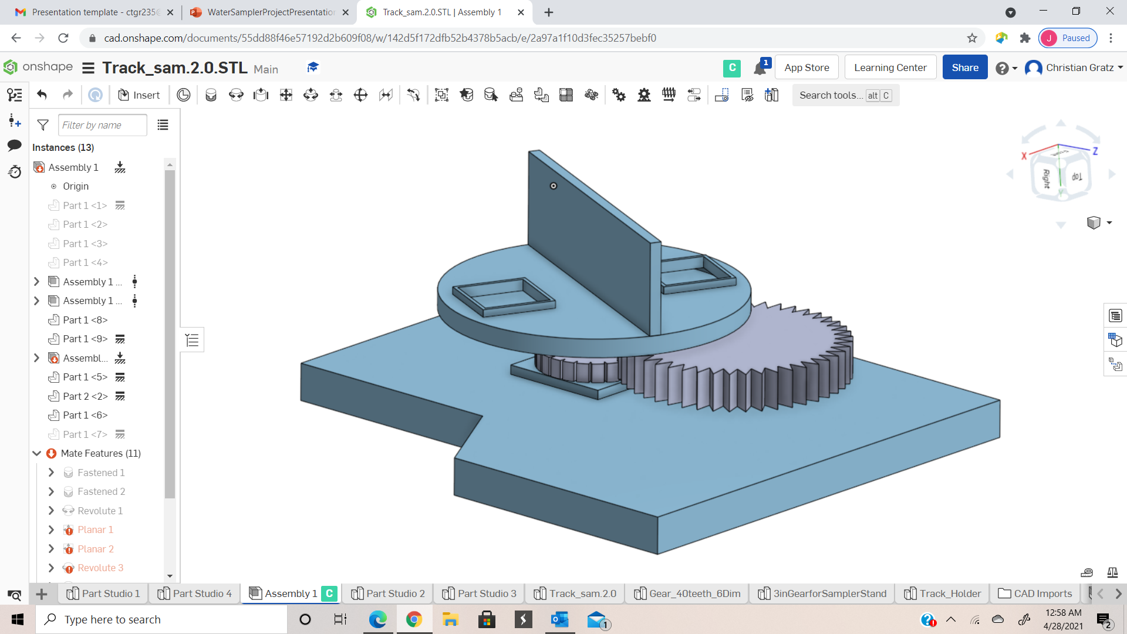
Rotational Base CAD Drawing
Rotating Base: consists of divider to separate sample containers and two designated positions for the cup to sit.
Gears: Driving gear (larger gear) is connected to the stepper motor. The driven gear (smaller gear) is fastened to the bearing and the rotating base.
Stepper Motor: Attached to the driving gear (shown in grey).
Bearing: Attached to the work-holding piece (shown in red).
Workholding Piece: Provides an area for all components to function properly and will attach to the sampler stand using dowels.
Bolt/Nut/Spacer: Crucial to the fastening of the rotating base and driven gear. Also elevates the rotating base to ensure alignment between gears.

Slide 15
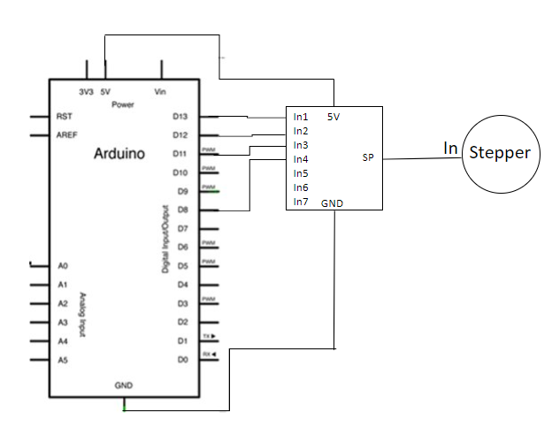
Rotational Base Electrical Schematic

Slide 16
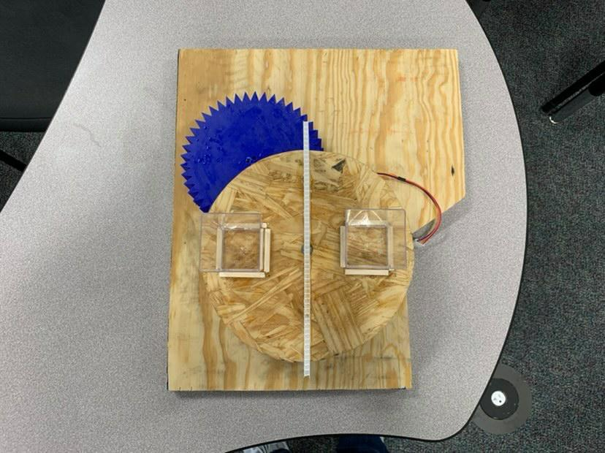
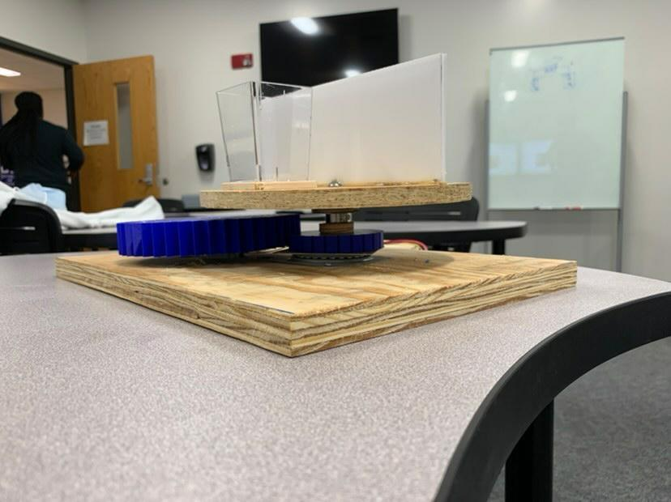
Rotational Base Prototype
Side View (left); Top View (right)

Slide 17
Rotational Base Calculations
The stepper motor moves approximately 10 revolutions/minute (1.047 radians/second). The container will sit approximately 3in from the center of the base.
Angular velocity: (1.047 radians/sec)*(3in) = 3.142 inches per second
Ratio of diameter speed: (6in/3in) = (1.047/x); x = 0.523 radians per second
Driving gear consists of 45 teeth
Driven gear consists of 24 slots for the gears to mesh

Slide 18
Final Design of Rotational Base
Challenges Faced:
Aligning the gears to ensure the gears always in contact
Determining the right amount of teeth per gear
Keeping the gears level
Reliability:
All components of the rotational base are properly assembled and can easily be taken apart if problems occurred with a component
The gears may have to be checked to make sure they're aligned and to make sure the bearing is obstructing the motion of the gears before the process begins

Slide 19
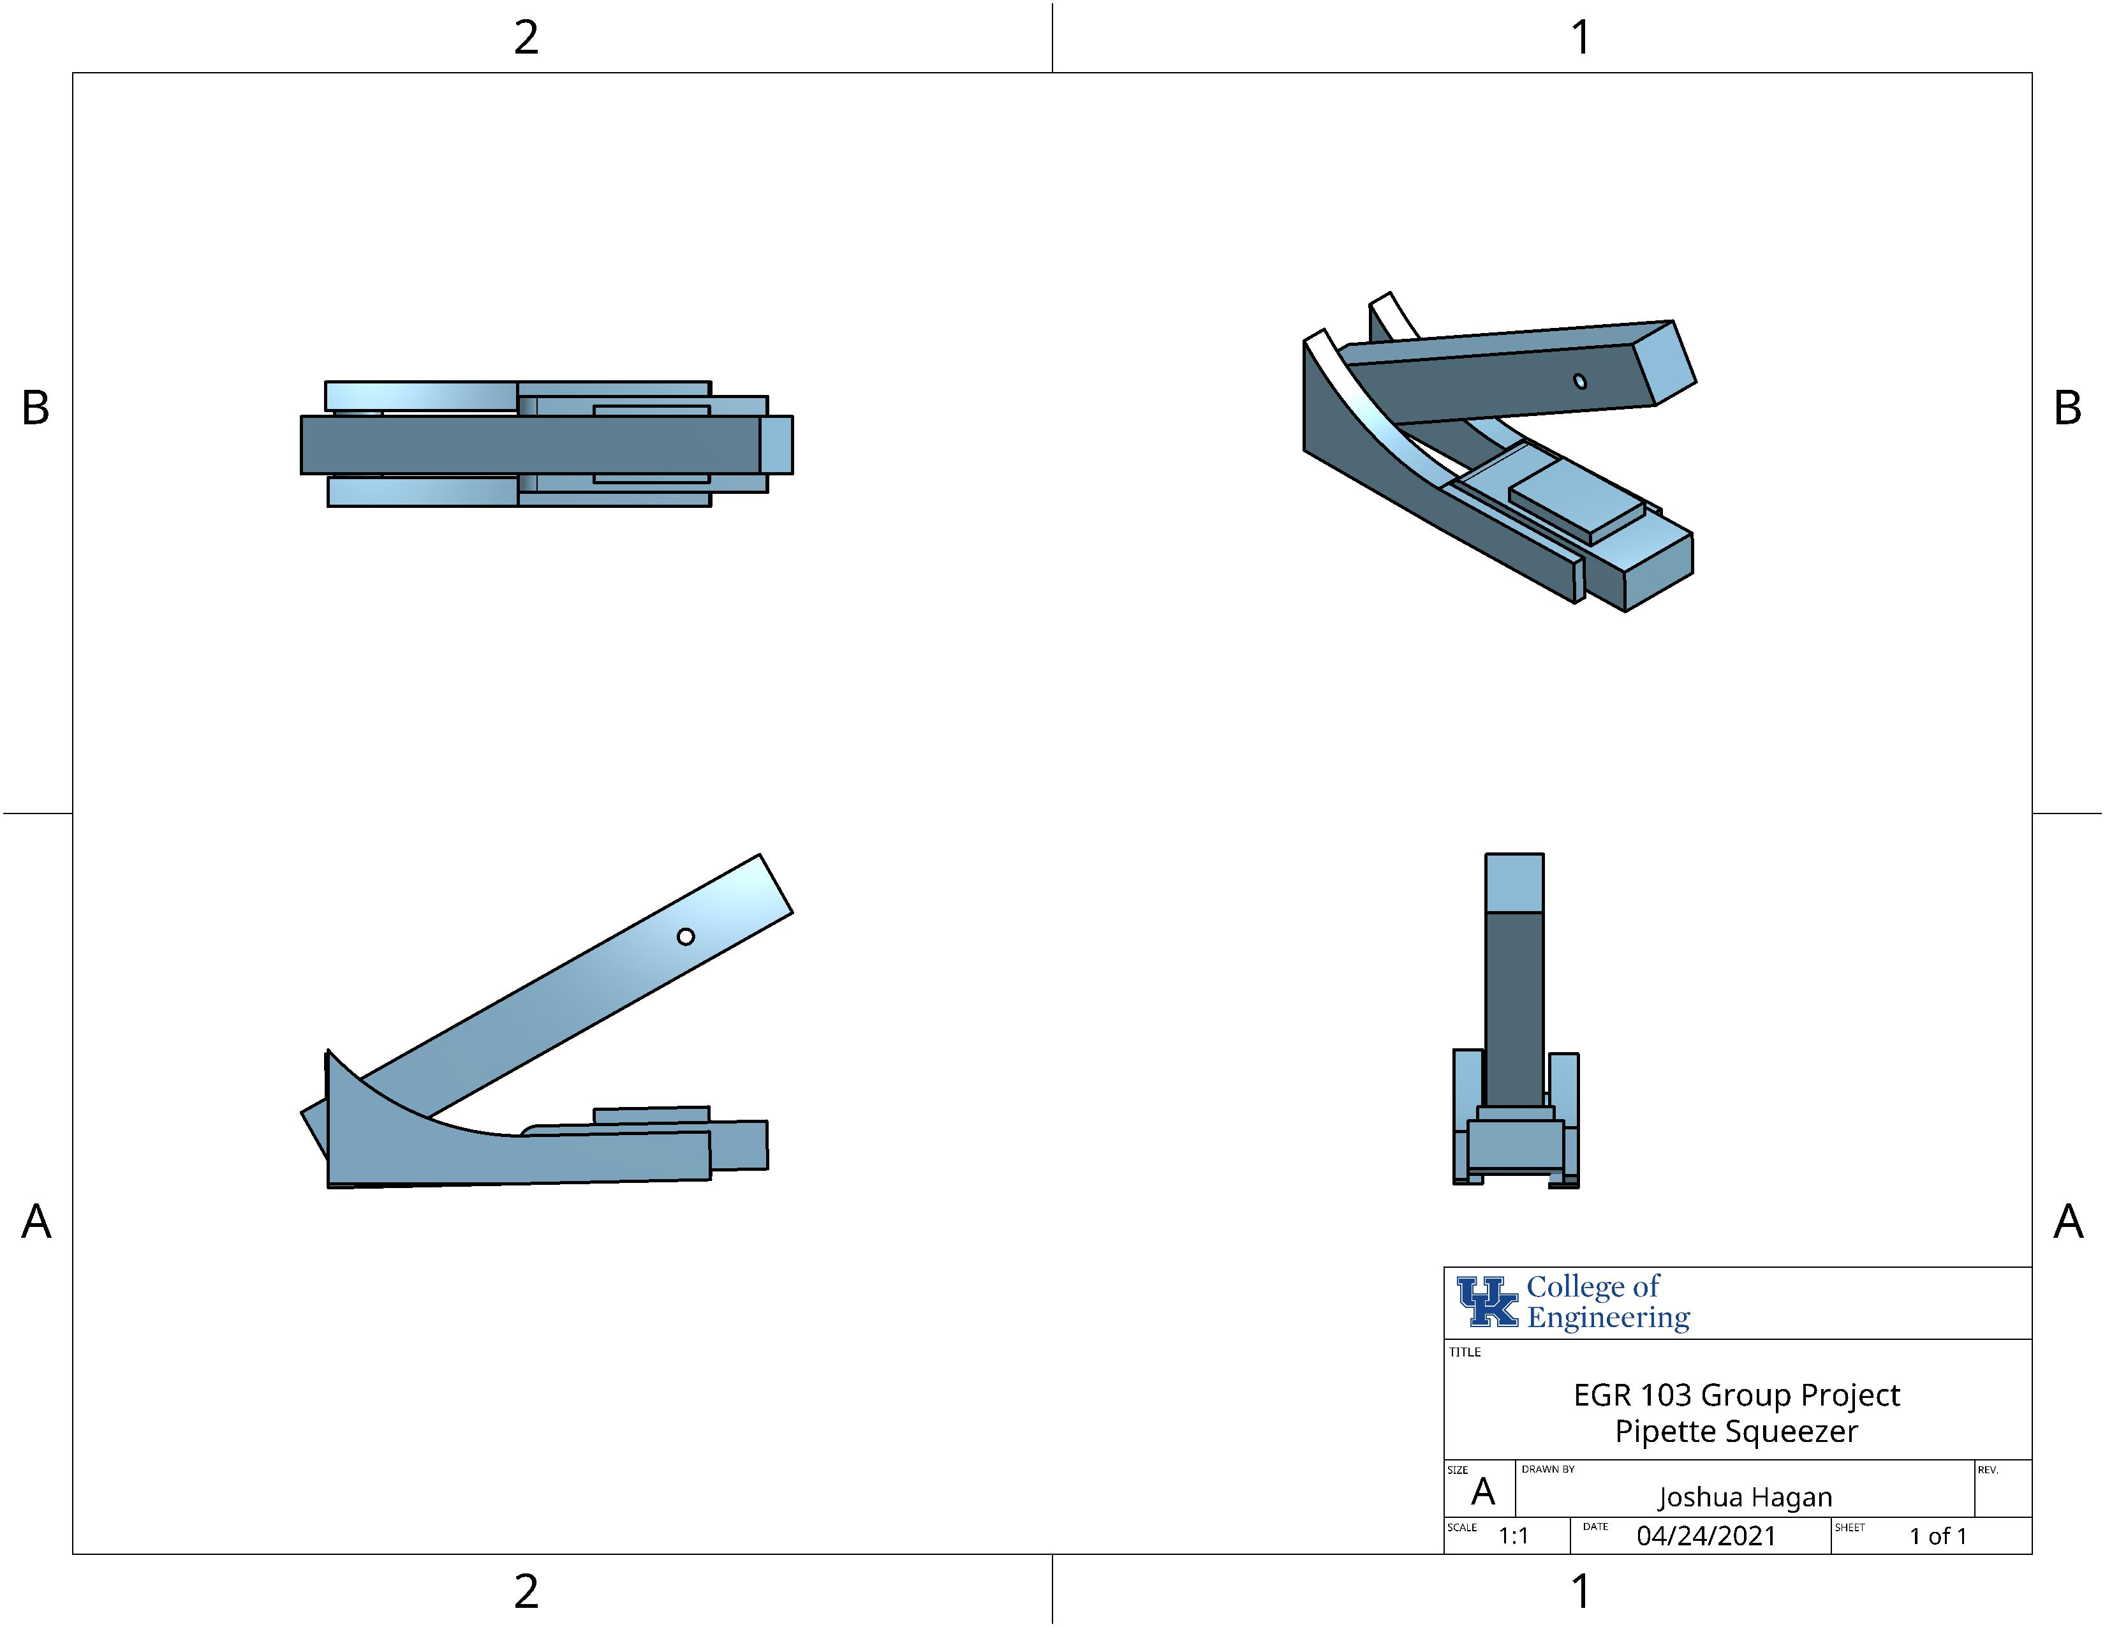
Pipette Squeezer Explanation and Drawing
The model that is displayed to the right is a representation of what should be attached to the Sampler Stand.
The function of this piece is to squeeze the pipette and be able to obtain at least 1 mL sample of a liquid.

Slide 20
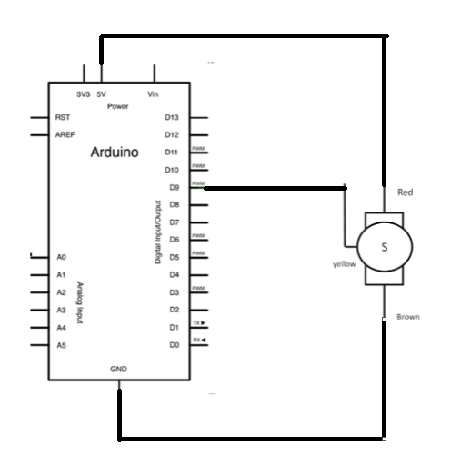
Pipette Squeezer Electrical Schematic
Red Section- Connects to the power supply
Yellow Section- Connects the servo to the Arduino for commands
Brown Section- Connects to the Ground

Slide 21
Pipette Squeezer Calculations
-------------------------------------------------------------------------------------------------------------------------------------
O = (-297.18g * 10.22cm) + (-122g * 7.3cm)+ (F_{B} * 6.35cm)
(6.35) * F_{B} = 3927.83g*cm
F_{B} = 618.56g
---------------------------------------------------------------------------------------------------------------------- O = (F_{L} * 8.76cm) + (-122g * 7.3cm) + (618.56g * 6.35cm)
F_{L} = 346.6g
T_{motor} = (346.6g) * (2cm)
T_{motor} = 693.2g*cm
-297.18g * 10.22 cm
-122g * 7.3 cm
13°
F_{B} * 6.35 cm
F_{L} * 8.76 cm
-122g * 7.3 cm
13°
618.56 g * 6.35 cm

Slide 22
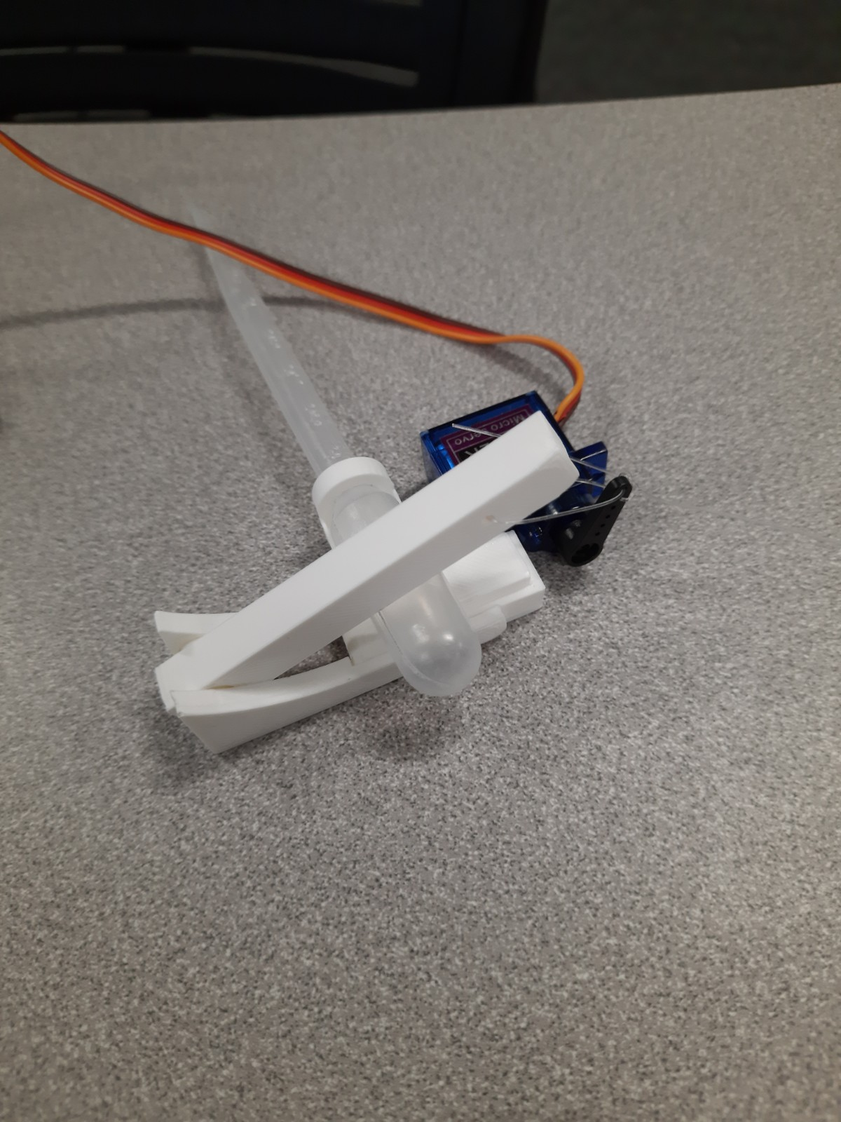
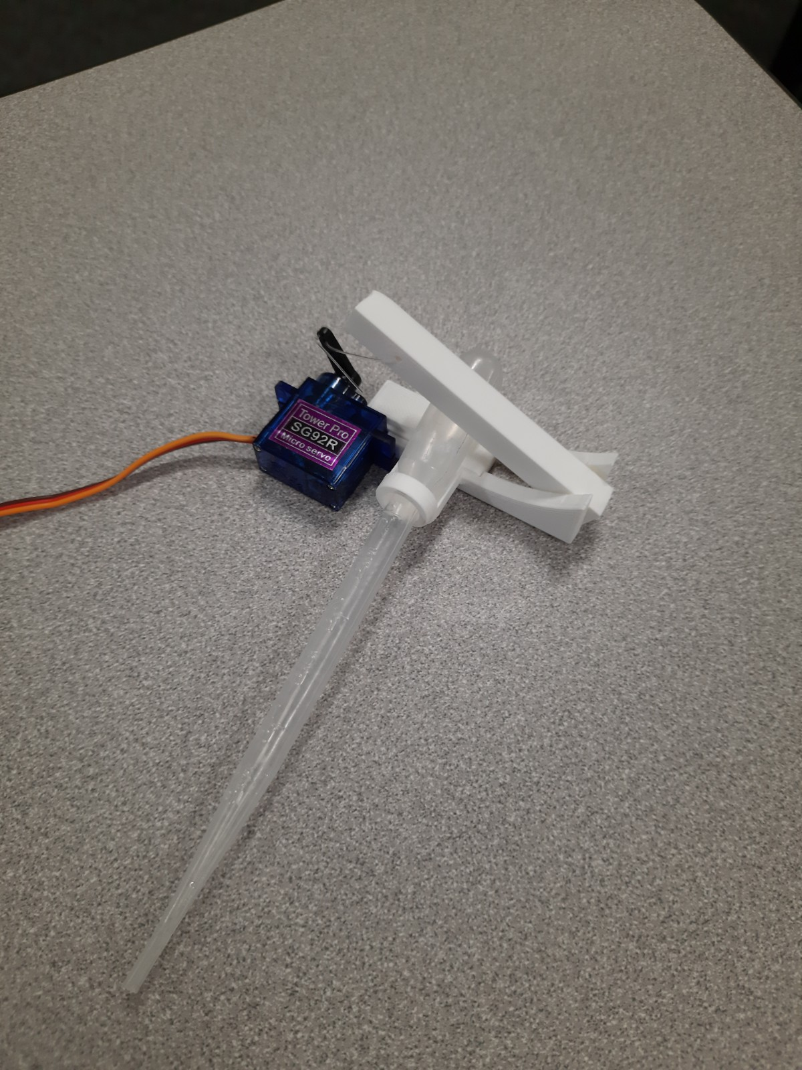
Pipette Squeezer Prototype
Back View
Front View

Slide 23
Pipette Squeezer Final Design and Performance Data
The design that was chosen for the Pipette Squeezer was to allow for maximum efficiency and simplicity. This simplicity would allow easy connection to other parts of the project
In testing of the performance on the individual subsystem of the Pipette Squeezer, it achieved the exact amount of water needed. 1mL of water was extracted in a series of 3 test from a container.
The challenge that was faced within this subsystem was to connect the individual pieces together. To solve this problem, adhesives were applied for the binding of the system.

Slide 24
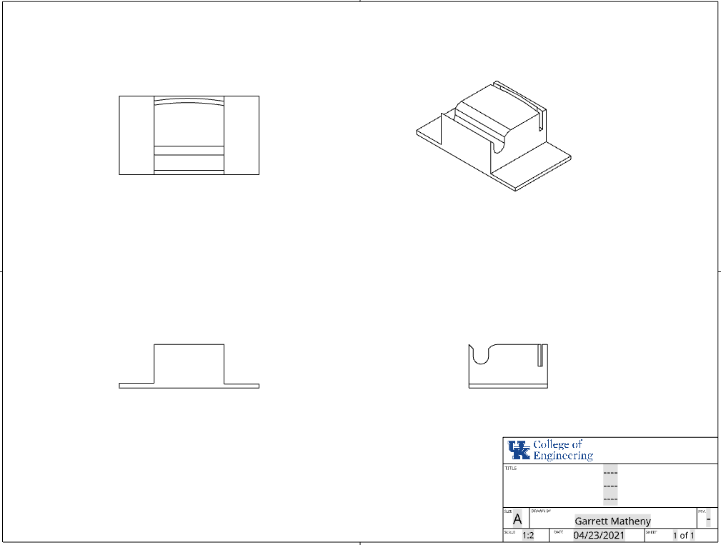
Vision System Mount Drawing
This drawing depicts the mount for the vision system. The intend was to use the base frame for the camera mount to fit inside the pockets hollowed out in the 3D model.

Slide 25
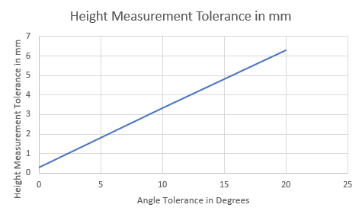
Vision System Mathematical Model
The purpose of this model was to determine the tolerances of the vision system.
It was determined that the angle threshold for our overall device does not exceed 20 degrees.

Slide 26
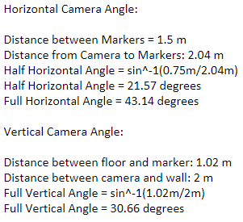
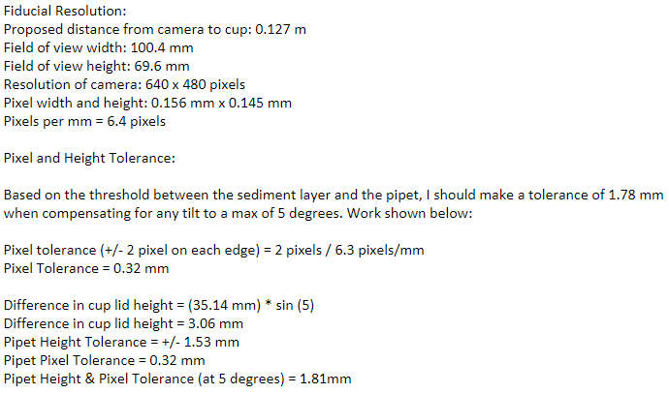
Vision System Calculations
Camera Angles: Pixel Conversion Factor and Tolerance:

Slide 27
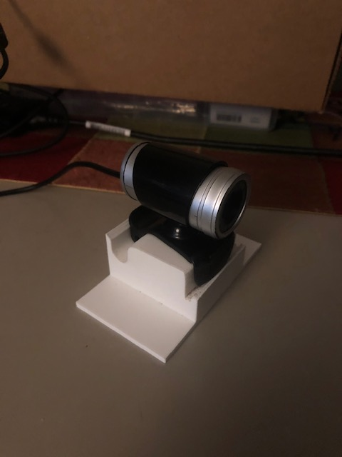
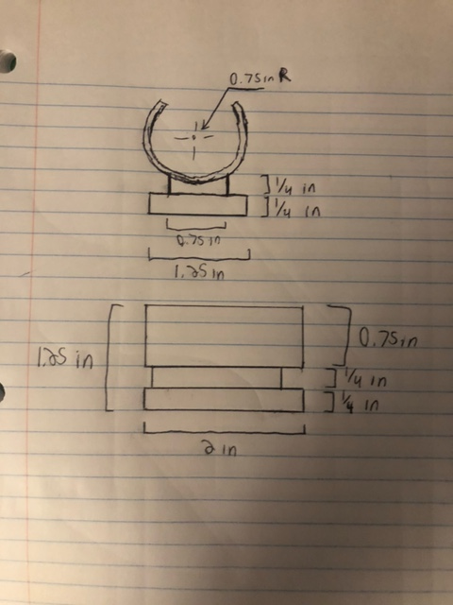
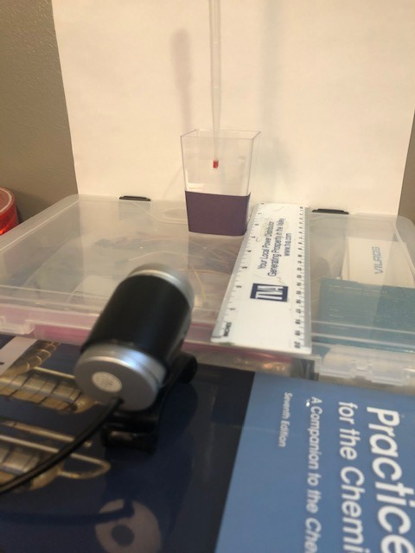
Vision System Prototype and Final Design
Prototype Setup and Mount: Final Vision System Mount and Camera:

Slide 28
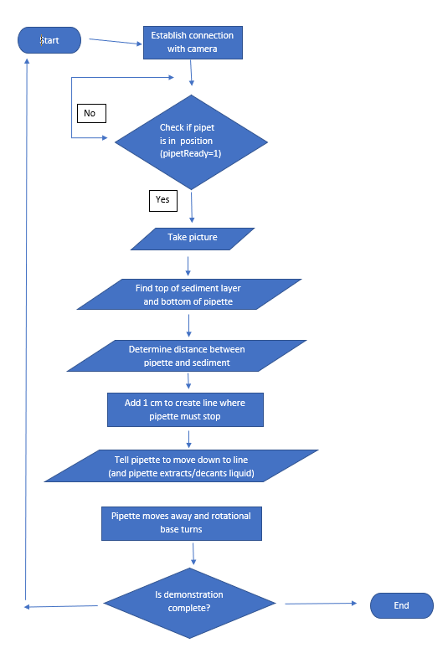
Vision System Flowchart (Initial)
Initially, this flow chart was created with the intent of tracking the distance between the end of the pipette marker and the top of the sediment layer by using a while loop.

Slide 29
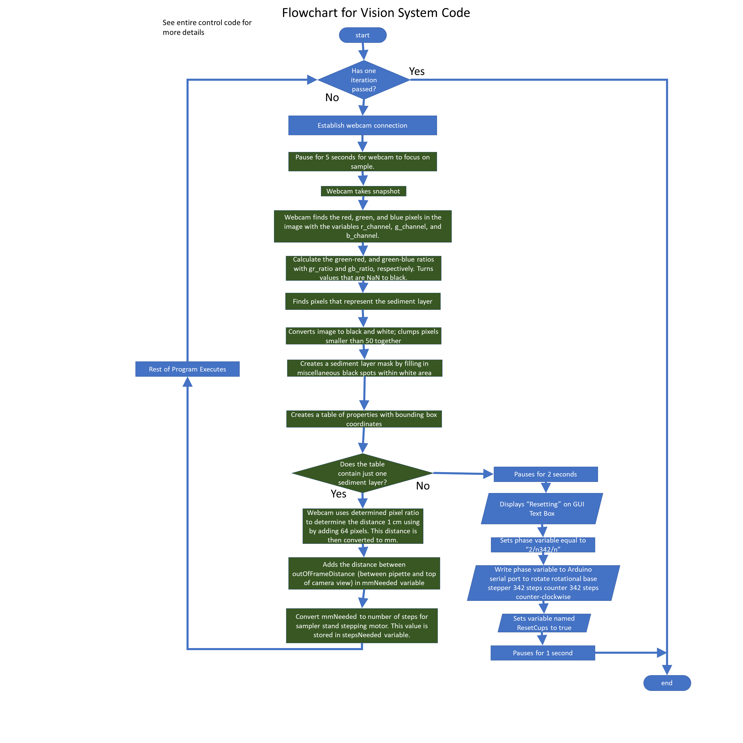
Vision System Flowchart Development
The difference between the initial flowchart and the revised flowchart is that the vision system only checks for the top of the sediment layer
This is based off the assumption that the distance between the pipette tip and the top of the frame would be relatively constant.
The next two slides provide section views of this flowchart.

Slide 30
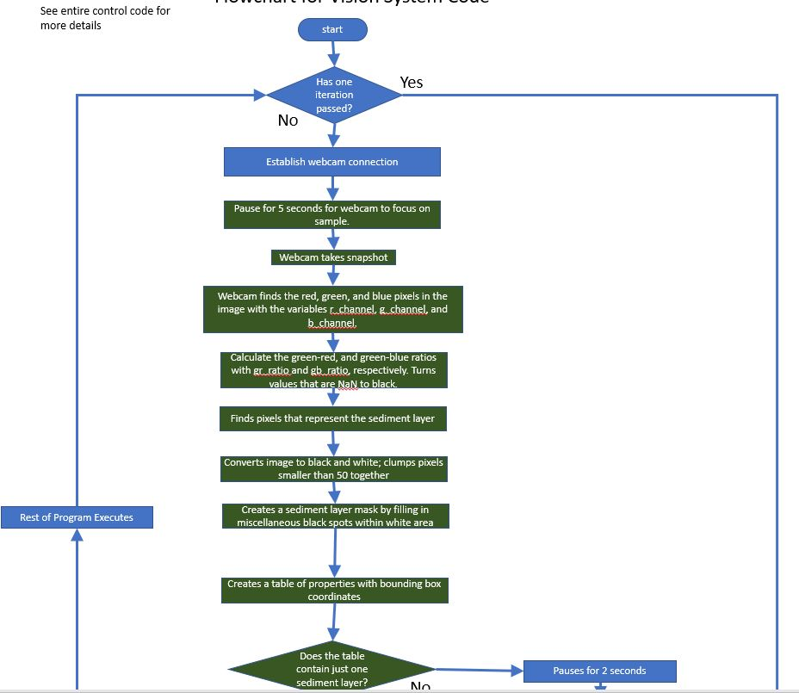
Vision System Flowchart (Top View)

Slide 31
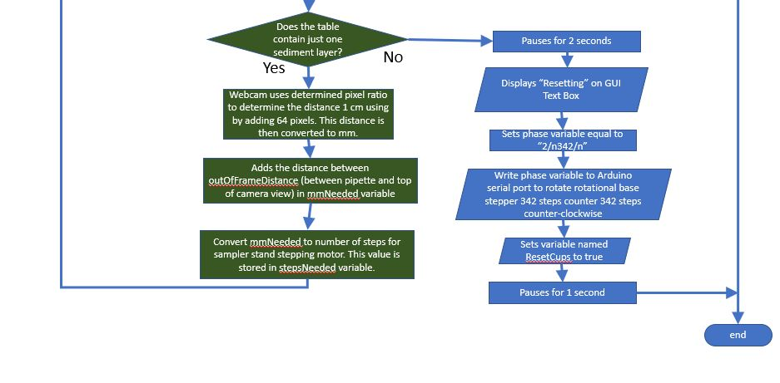
Vision System Flowchart (Bottom View)

Slide 32
Vision System Final Design and Performance
The intent of the physical design of the vision system was to allow for easy adjusting, but not so much that it would move on its own. I feel like my subcomponent is effective in finding the sediment layer and performing the other tasks it is given.
There were a few roadblocks along the way, such as problems with the code getting a bit complicated when attempting to find both the pipette and the sediment layer. There was also an issue with what we believed to be lighting, as we were getting a very bright image that messed the coloring and reading of the image. It was fixed by pausing the code and allowing the camera to focus.
To challenge my system, I ran it through the code five times in slightly different lighting. It was able to find the sediment layer every time because I have been able to open up the constraints on the tool that finds and fills that layer.

Slide 33
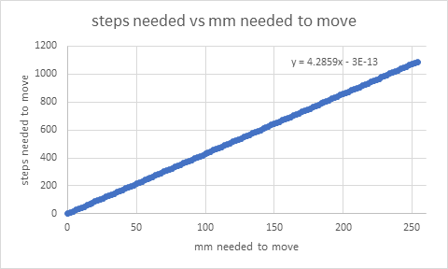
Control Code (Mathematical Model)
This main purpose behind this model was to create an equation that would tell how far the sampler stand needed to move the pipette squeezer.
The gear that is attached to the sampler stand, which meshes with a gear rack, was determined to have a radius of 76.2 mm.
Found circumference of the gear to determine the number of revolutions that would occur for a specified distance in mm.
Converted revolutions to number of steps required per revolution, which was 2052 steps.
The maximum distance that our pipette needed to travel was determined to be 254 mm, which equates to about 1089 steps
Thus, the derived equation for moving the pipette in the control code was the following:
stepsNeeded = round(4.2859 * mmNeeded)

Slide 34
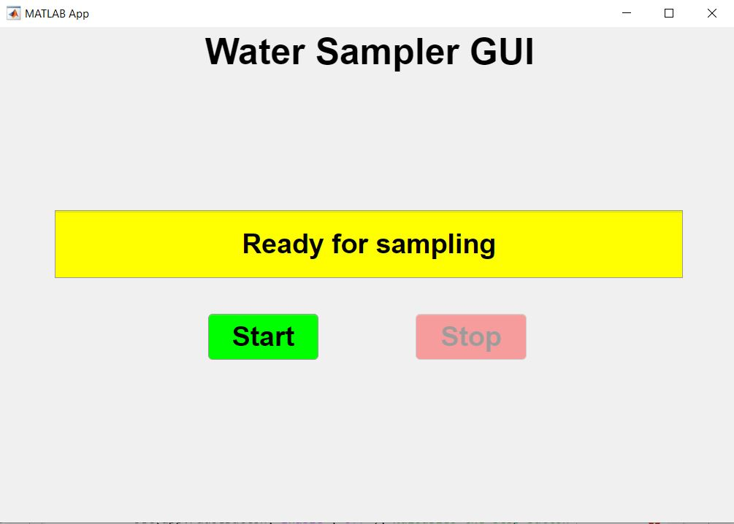
Control Code (Initial GUI Design)
This was the original design as specified in the Control Code Proof of Concept Document.
There are not many options for the user to control because the water sampling process was thought to be more automated than user-controlled.
The Start Button is where the user would commence the sampling cycle.
The Stop Button is where the user would press the button to stop the control code. The main function of this button was to trigger the break statements within the control code to stop the sampling cycle before completion.
The yellow box is what is referred to as the descriptor box, which tells the user what is going on during the sampling cycle. The descriptor box also warns the user to place the sediment container and the water-absorbing polymer in their designated locations.
Title of GUI
Exit “x”
Descriptor Box
Start Button
Stop Button

Slide 35
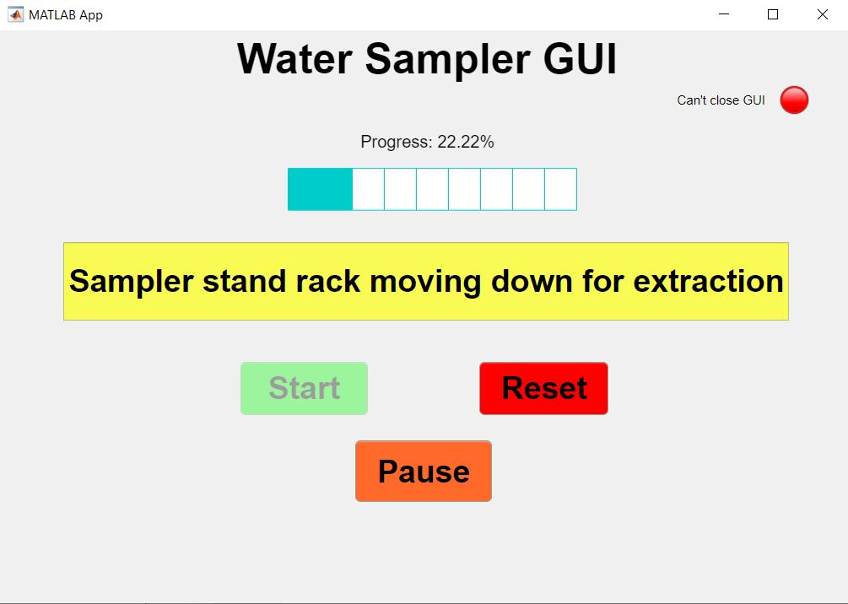
Control Code (Final GUI Design/Prototype)
Exit “x”
On the final GUI design, all of the features and their functionality from the original GUI were retained. As time progressed, I discovered how to create other features that improved my GUI
The progress bar and progress label were incorporated into the design to provide a visual representation of how far the water sampling cycle has gone.
The lamp and lamp label (located near the top right hand corner), indicates to the user when they are allowed to close the GUI.
The pause button was the most recent feature added onto my GUI after peer reviews. Although the user can access this option any time while sampling is happening, the main purpose of this button was to prevent the machine from operating for too long after potential malfunctions.
Title of GUI
Progress Label
Progress Bar
Lamp Label
Lamp
Descriptor Box
Start Button
Reset button
Pause button

Slide 36
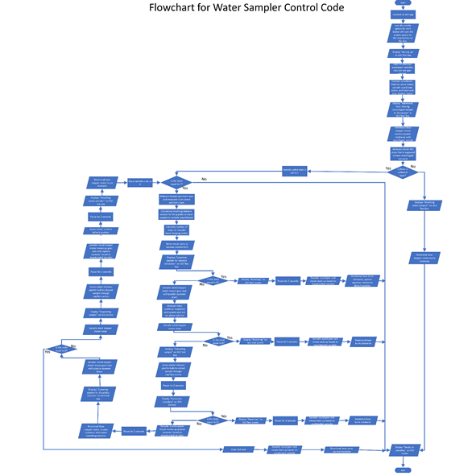
Control Code (Initial Flowchart Design)
The original intent behind this design was to solely utilize Matlab and its functions to move each of the motors.
A while loop was considered to be used for the majority of the control code program. This allowed me to place break statements within the code, which would allow the user to escape the program if they desired (see Initil GUI Design for more information).
Since the majority of the control code was planned to be enveloped in a while loop, a condition at the end of the loop needed to be set if a full sampling cycle was completed. This was to prevent the process from repeating more than once.

Slide 37
Control Code Final Structure
For the final version of the control code, I found that putting all my code within a for loop actually made my program simpler because for loops only run for a finite number of times.
My program complexity grew because the GUI became more complex, which required more components to update while the control code was running.
It was also discovered that the stepper motor speeds using Matlab commands were incredibly slow, which was problematic because our machine needed to operate in under four minutes.
The solution to these issues resulted in a combined control code functionality, where Matlab and Arduino communicate with each other.

Slide 38
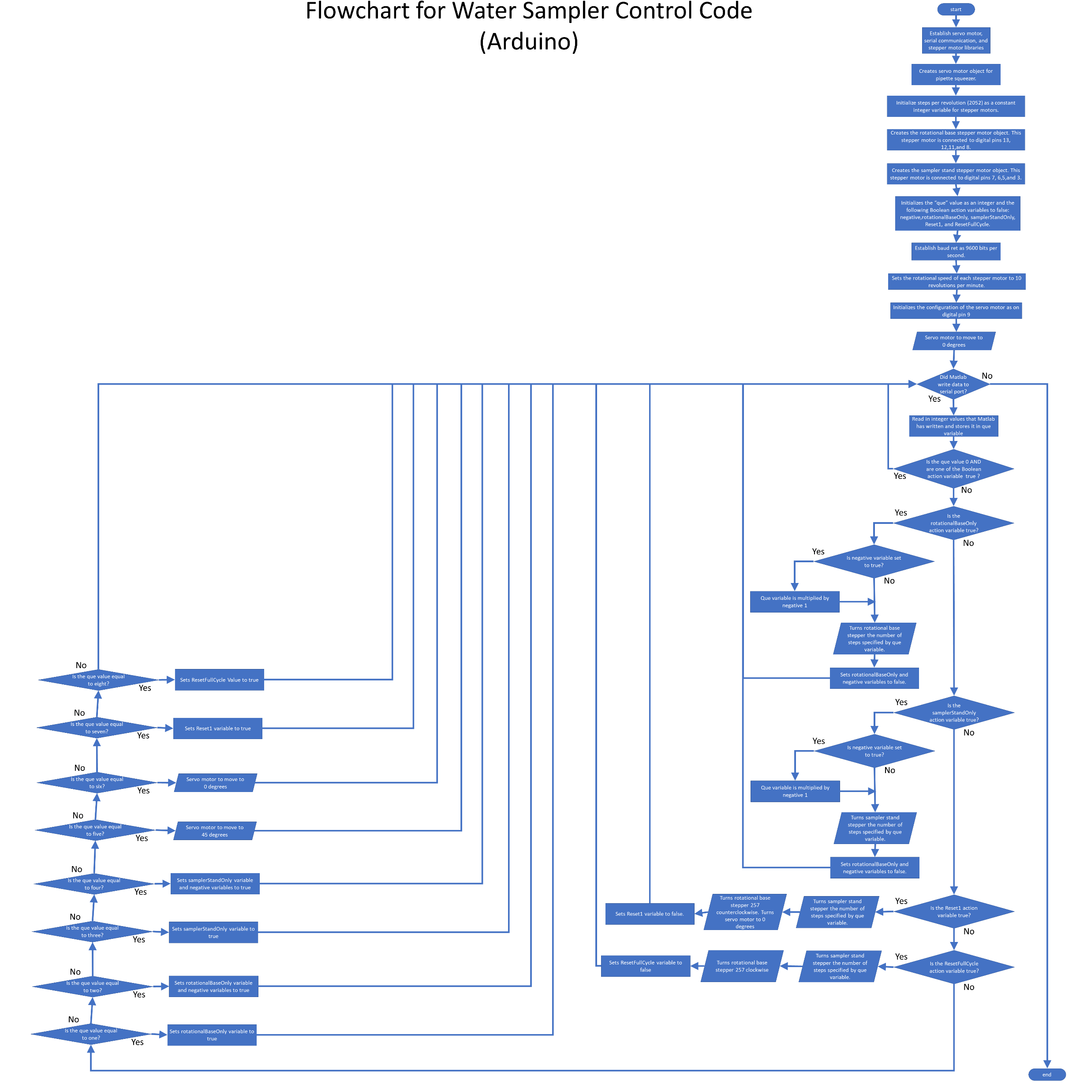
Final Control Code (Arduino)
There were several main reasons why an Arduino sketch became a part of the control code:
As mentioned in the previous slide, the stepper motor speed was a problem. With the built in Matlab commands, the stepper motors move very slowly.
There were also issues when the servo motor and stepper motors were connected to the same Arduino board. All motor objects were established in an Arduino sketch to prevent any such errors with “sharing” the same Arduino board.
The Arduino code also helps coordinate the movement of the motors and ensures they do not run at the same time.
The functionality of this component of the control code is discussed in the next four slides

Slide 39
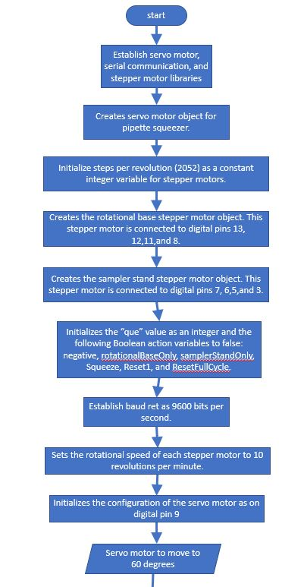
Final Control Code (Arduino Flowchart View 1)
This part of the Arduino code is the setup, where the control code establishes the libraries for the servo motor, stepper motor, and serial communication functions.
This part creates each of motor objects, sets the speed of the stepper motors, and initializes the default angle on the servo motor.
Initializes action variables, which are Boolean, as “false”.

Slide 40
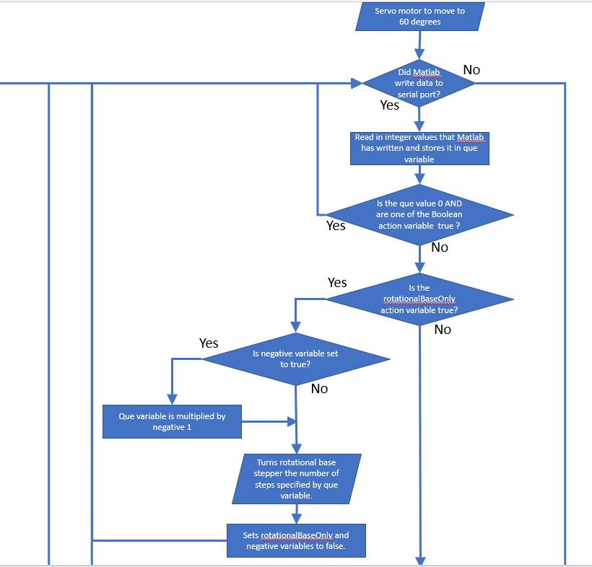
Final Control Code (Arduino Flowchart View 2)
This is a part of the control code where Arduino assess which scenario to execute.
This is the point in the program where Arduino finds any data that was written in its serial port.
If Arduino finds a valid integer value, it reads and stores it in a "que" variable.
The “que” variable serves as an indication of what is supposed to happen.
To assess the meaning of the que value, Arduino process it through a series of if and else-if statements.

Slide 41
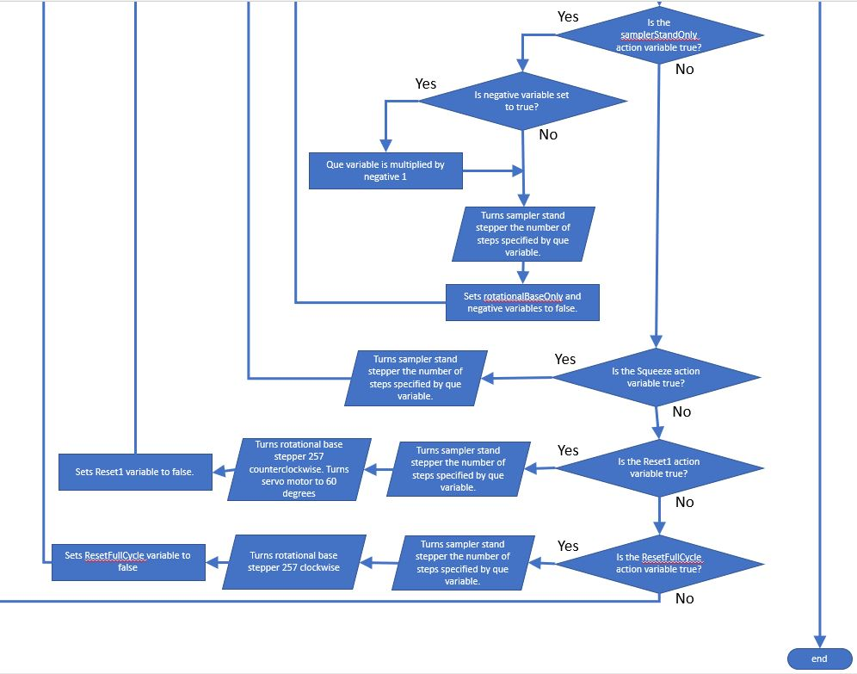
Final Control Code (Arduino Flowchart View 3)
A continuation of the execution statements from the previous slide
For example, if the que variable is equal to one, Arduino sets the rotationalBaseOnly value to “true”. This lets the arduino know that the next number after the "1" represents the number of steps (clockwise) that the rotational base stepper motor needs to turn.
After the action is executed, Matlab resets the action to false so that the action will not repeat itself indefinitely.

Slide 42
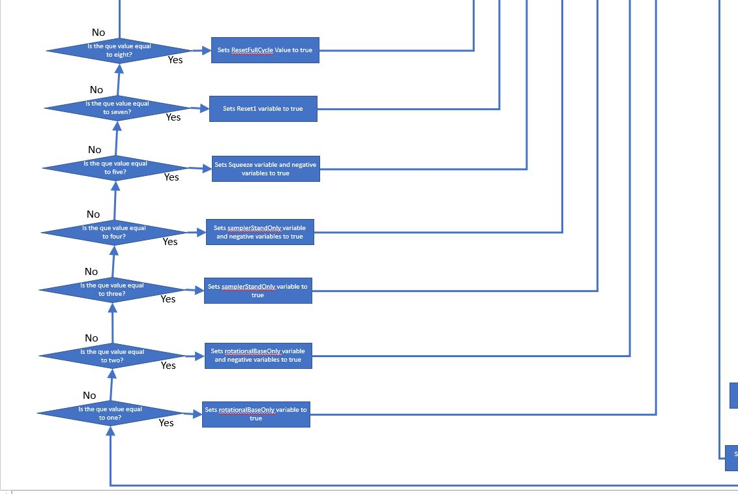
Final Control Code (Arduino Flowchart View 4)
This is a continuation of the action execution that Arduino performs.
For example, if the que value is “5”, then the Squeeze action variable is specified as true, which means the servo motor will move. The next value coming after the five represents the angle that the servo motor needs to turn.

Slide 43
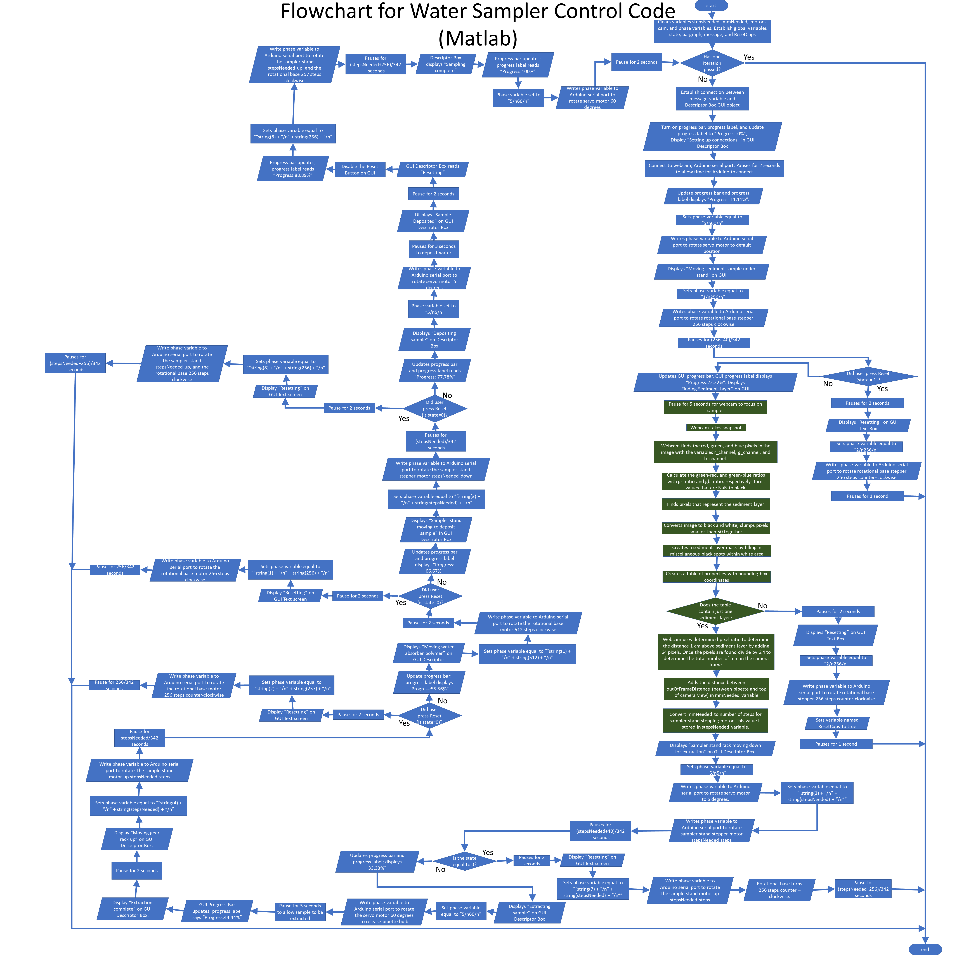
Final Control Code (Matlab)
Matlab serves two important functions:
Matlab is the signaler, meaning that it writes data in the serial port to tell Arduino which motor or motors need to move, and writes the data to the Arduino serial port. Matlab controls WHEN the motors move.
Matlab helps update the Water Sampler GUI so that it does not run ahead of the action that is occurring by Arduino
Because this flowchart is hard to see, the overall flowchart was divided into section views.
Each section is highlighted in the next eight slides.

Slide 44
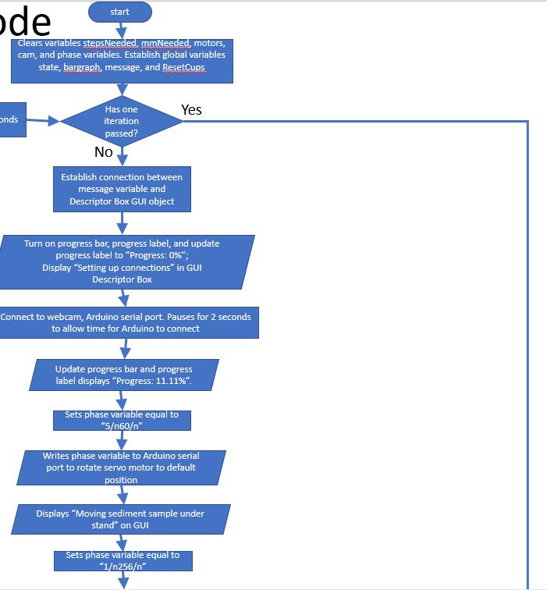
Final Control Code (Matlab Flowchart View 1)
The first view represents the "Set-up" of the sampling cycle.
The program starts, clears variables that may have been used during previous sample cycles.
It establishes connections between the Water Sampler GUI and its components, the Arduino serial port, and the vision system’s webcam.
The control code initializes the servo motor position to sixty degrees.
Enters a for loop to begin execution of control code.

Slide 45
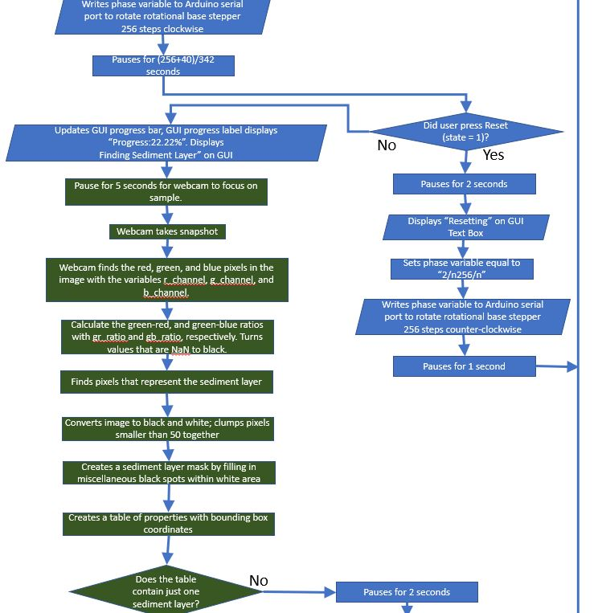
Final Control Code (Matlab Flowchart View 2)
The rotational base rotates 90 degrees counter-clockwise with what it assumes to be sediment layer sample.
If the user presses the Reset button, then the water sampler turns the rotational base 90 degrees clockwise to reset.
Otherwise, the program waits for five seconds for the web camera to focus to take a picture of the container and to take a snapshot.
This is where it determines whether the cup in the vision system’s view has a “valid” sediment layer.

Slide 46
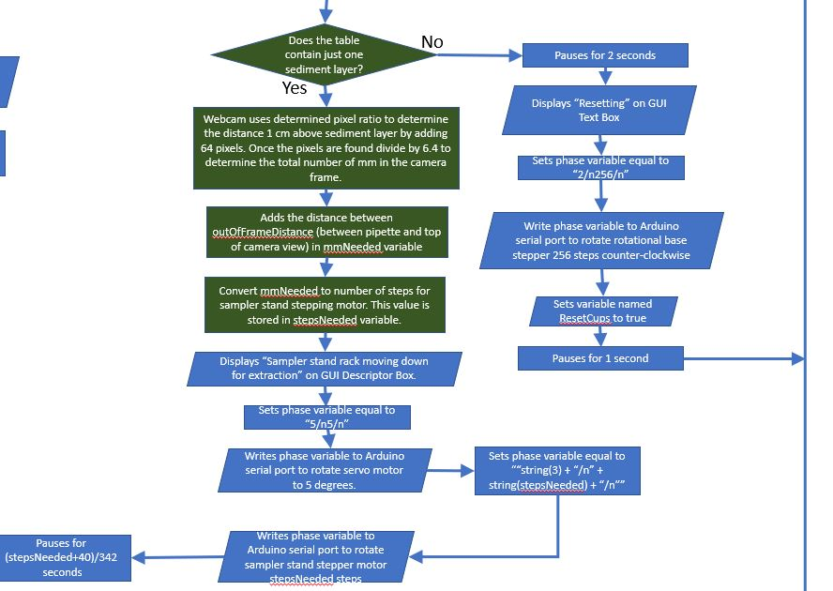
Final Control Code (Matlab Flowchart View 3)
The assumption at the beginning of the control code was that the sediment layer cup and the water absorbing polymer cup were placed in their designed locations.
The control code conducts RGB analysis on the cup and attempts to find a sediment layer.
If there is no valid sediment layer, the water cycle is exited and the water sampler resets automatically and lets user know that the containers need to be placed in the correct location.
Otherwise, the sampler determines what 1 cm above the sediment layer is, calculates the total mm needed, and converts those mm to steps using the control code mathematical model.
The servo motor squeezes the pipette bulb, and the sampler stand moves down.

Slide 47
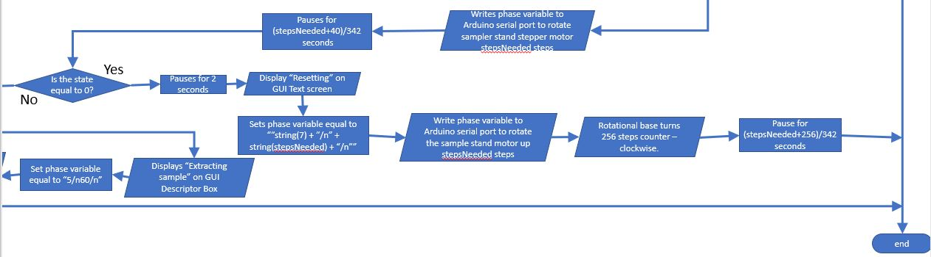
Final Control Code (Matlab Flowchart View 4)
If the user presses the Reset button, the sampler stand moves up and the rotational base moves 90 degrees clockwise.

Slide 48
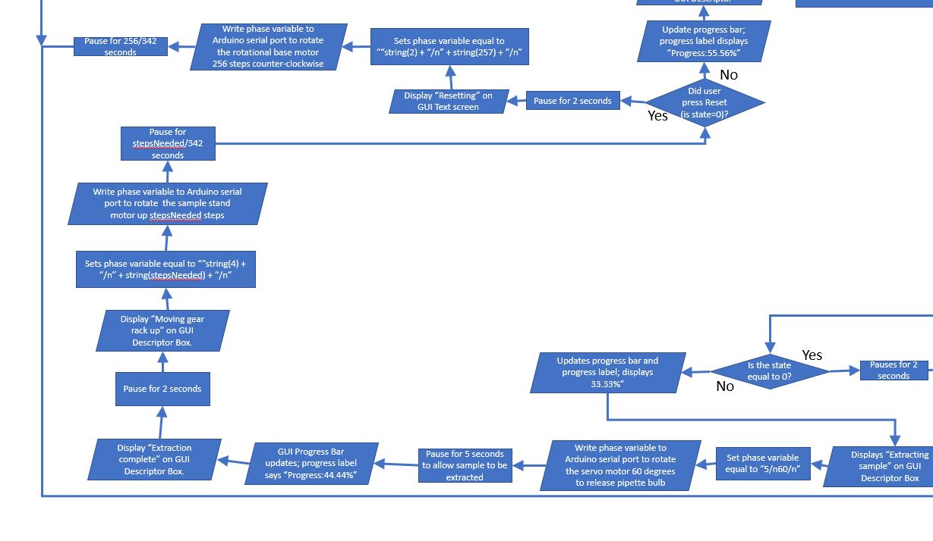
Final Control Code (Matlab Flowchart View 5)
Otherwise, the servo motor turns 60 degrees to extract sample, the machine pauses for 5 seconds.
Once extraction is complete, the sampler stand motor moves back up.
If the user pressed the Reset button by the time the sampler stand moved back up, the rotational base rotates 90 degrees clockwise.

Slide 49
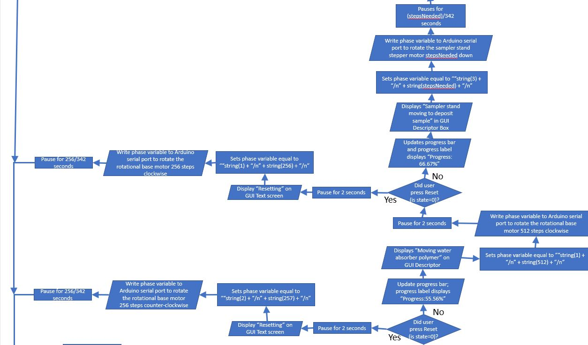
Final Control Code (Matlab Flowchart View 6)
The rotational base moves 180 degrees counter-clockwise to position the empty container under the sampler stand.
If the user presses the Reset button, the rotational base rotates 90 degrees counter-clockwise.
Otherwise, the sampler stand motor moves down to deposit sample.

Slide 50
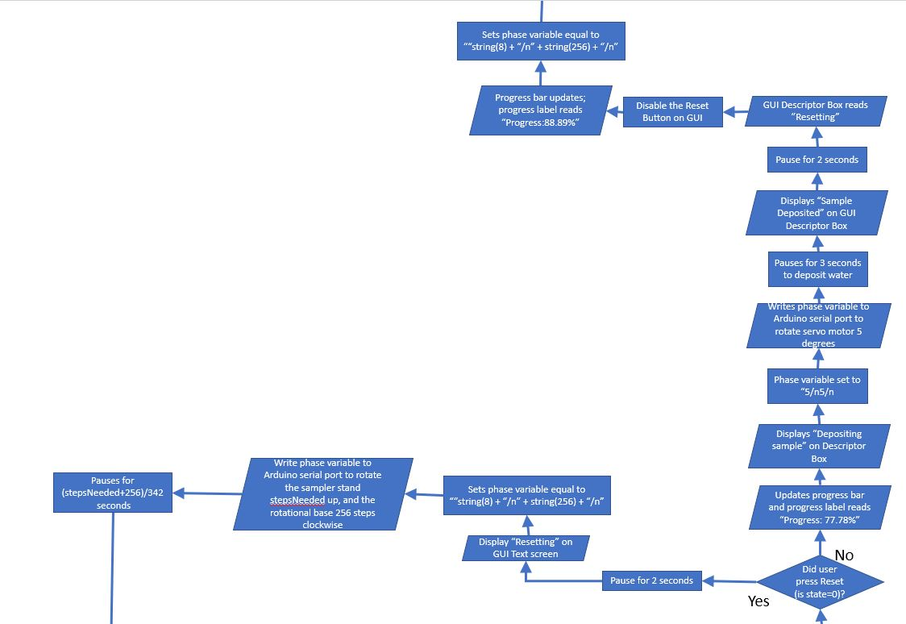
Final Control Code (Matlab Flowchart View 7)
If the user pressed the Reset button by the time the sampler stand moves down, the sampler stand moves back up and the rotational base rotates 90 degrees counter-clockwise
Otherwise, the servo motor turns 5 degrees to deposit the sample.
The Reset button is disabled on the GUI because the program automatically resets after the sample is deposited.

Slide 51
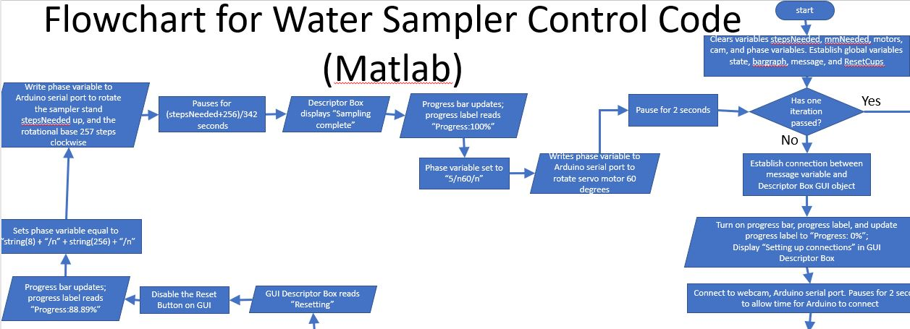
Final Control Code (Matlab Flowchart View 8)
Assuming that the user did not press the Reset button during this entire process, the sampler stand moves up, the rotational base rotates 90 degrees counter-clockwise, and the servo motor resets back to 60 degrees.
This point marks the end of the first iteration, and the for loop is exited.
The user can conduct additional samples once the machine resets.

Slide 52
Control Code Demonstration Link
The below link provides a rough demonstration of the Control Code, since the Water Sampler has not been completely assembled:
Link:https://youtu.be/IfsVF-qi-3Q

Slide 53
Control Code Final Design Comments
As mentioned in prior slides, the program and GUI were set up to where the user could control little about how the program itself operates.
In terms of the buttons that were used, the Start and Reset buttons could have been combined into one button.
Other teams did not interpret this process to be as automated, and thus had more buttons than the GUI shown in this presentation. (I.e. one button for servo motor, one button for the sampler stand stepper motor,etc). The GUI could have added additional buttons in case the machine malfunctioned and the user wanted to reset the structure.

Slide 54
Project Management Information

Slide 55
Economic Analysis
The majority of members in our group worked between 30 to 45 hours on this projects.
The average labor cost for each team varied between $1500 and $3000.
As of April 28, 2021, our total cost came to be around $93.49. It is most likely to be more than that because we will be working on our design this week.
The next three slides show the images of the Hourly Commitment, Labor Cost, and Bill of Materials.

Slide 56
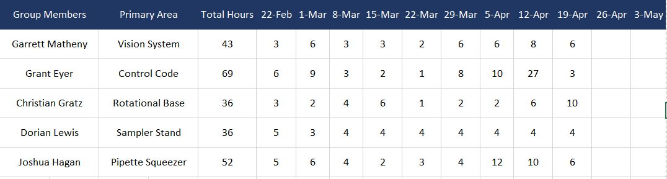
Hours Worked

Slide 57

Labor Cost

Slide 58

Bill of Materials

Slide 59

Gantt Chart
There were a couple of challenges with the management of this project.
Some aspects of our design process took longer than expected due to conflicting schedules with team members.
Some of the 3D printed parts also took longer to print than expected, which put Group C behind schedule.

Slide 60
Overall Conclusions
Our machine was not completely functioning at the time of this presentation. Therefore, there was not much performance analysis conducted. However, some progress has been made:
The sampler stand gear rack moves somewhat well, the rotational base gear systems move somewhat well, and the vision system can clearly outline the sediment layer. The control code cannot yet be tested because the water sampler was not entirely assembled.
We plan to demonstrate the functionality of our overall sampler device on Friday 30, 2021 at 3:00 pm.

